Slide 1

Oracle Database 10g: SQL Fundamentals I
Electronic Presentation
D17108GC11
Production 1.1 August 2004 D39769
®

Slide 2

Author
Copyright © 2004, Oracle. All rights reserved.
Nancy Greenberg
This documentation contains proprietary information of Oracle Corporation. It is provided under a license agreement containing restrictions on use and disclosure and is also protected by copyright law. Reverse engineering of the software is prohibited. If this documentation is delivered to a U.S.
Technical Contributors and Reviewers
Government Agency of the Department of Defense, then it is delivered with Restricted Rights and the following legend is applicable:
Wayne Abbott Christian Bauwens Perry Benson
Restricted Rights Legend
Use, duplication or disclosure by the Government is subject to restrictions for commercial computer software and shall be deemed to be Restricted Rights software under Federal law, as set forth in subparagraph (c)(1)(ii) of DFARS 252.227-7013, Rights in Technical Data and Computer Software (October 1988).
Brian Boxx Zarko Cesljas Dairy Chan
Laszlo Czinkoczki Marjolein Dekkers Matthew Gregory Stefan Grenstad Joel Goodman
This material or any portion of it may not be copied in any form or by any means without the express prior written permission of Oracle Corporation. Any other copying is a violation of copyright law and may result in civil and/or criminal penalties.
If this documentation is delivered to a U.S. Government Agency not within the Department of Defense, then it is delivered with “Restricted Rights,” as defined in FAR 52.227-14, Rights in Data- General, including Alternate III (June 1987).
Rosita Hanoman Sushma Jagannath Angelika Krupp
Christopher Lawless Marcelo Manzano Isabelle Marchand Malika Marghadi Valli Pataballa
The information in this document is subject to change without notice. If you find any problems in the documentation, please report them in writing to Education Products, Oracle Corporation, 500 Oracle Parkway, Box SB-6, Redwood Shores, CA 94065. Oracle Corporation does not warrant that this
document is error-free.
Oracle and all references to Oracle products are trademarks or registered trademarks of Oracle Corporation.
Elspeth Payne
Ligia Jasmin Robayo Bryan Roberts
All other products or company names are used for identification purposes only, and may be trademarks of their respective owners.
Helen Robertson Lata Shivaprasad John Soltani
Priya Vennapusa Ken Woolfe
Publisher
Jobi Varghese

Slide 3

Introduction
Copyright © 2004, Oracle. All rights reserved.

Slide 4

Lesson Objectives
After completing this lesson, you should be able to do the following:
•
List the features of Oracle10g
•
Discuss the theoretical and physical aspects of a
relational database
• Describe the Oracle implementation of the RDBMS
and ORDBMS
• Understand the goals of the course
Copyright © 2004, Oracle. All rights reserved.

Slide 5
Goals of the Course
After completing this course, you should be able to do the following:
• Identify the major structural components of
Oracle Database 10g
•
Retrieve row and column data from tables with the
SELECT statement
•
Create reports of sorted and restricted data
•
Employ SQL functions to generate and retrieve
customized data
• Run data manipulation language (DML) statements
to update data in Oracle Database 10g
• Obtain metadata by querying the dictionary views
Copyright © 2004, Oracle. All rights reserved.

Slide 6
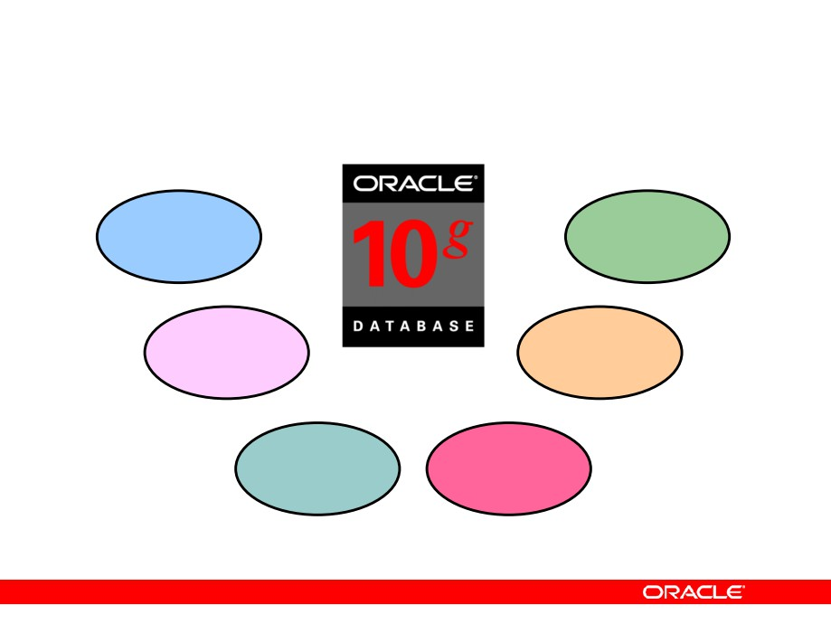
Oracle10g
One
Scalability
vendor
Unified
Reliability
management
Single
Common skill sets
development model
Copyright © 2004, Oracle. All rights reserved.

Slide 7
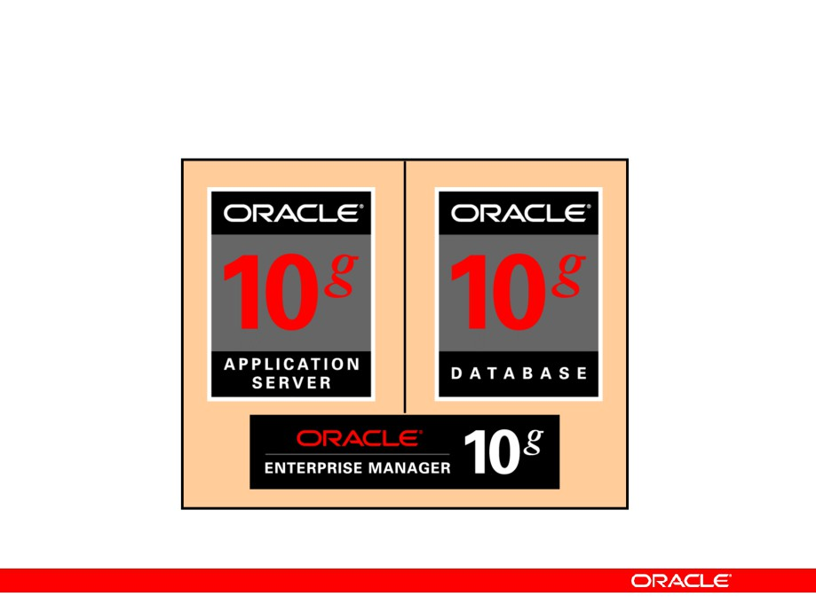
Oracle10g
Copyright © 2004, Oracle. All rights reserved.

Slide 8
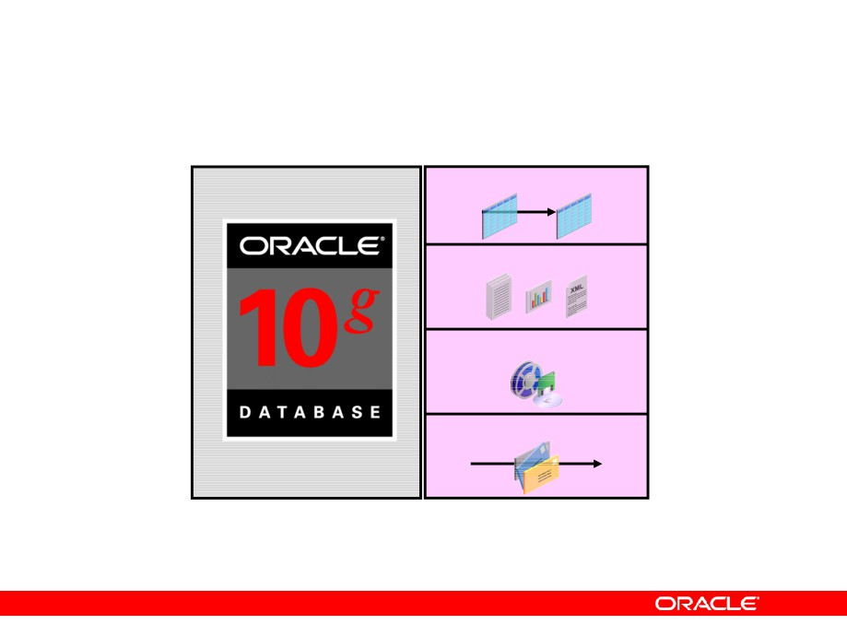
Oracle Database 10g
Object relational data
Documents
Multimedia
Messages
Copyright © 2004, Oracle. All rights reserved.

Slide 9
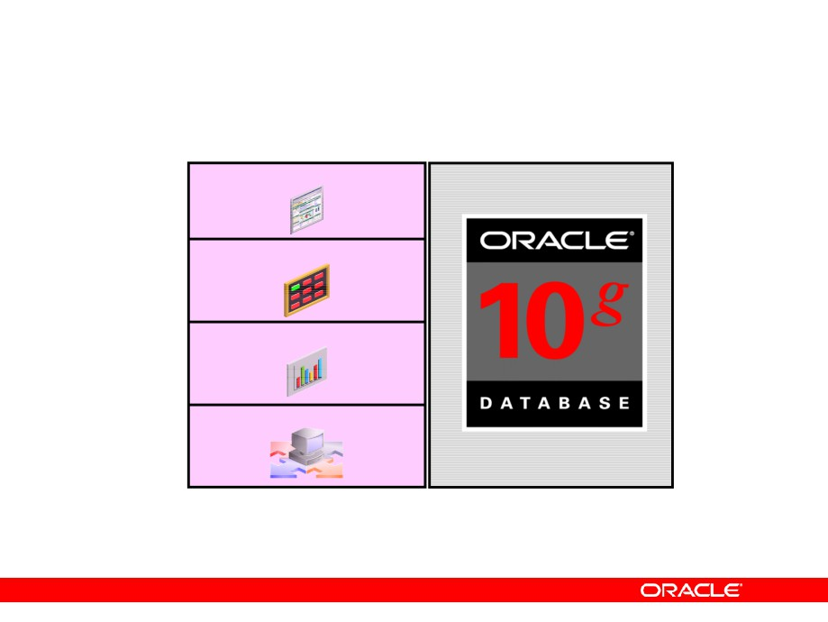
Oracle Application Server 10g
Portals
Transactional applications
Business intelligence
Integration
Application
Application
development
server
framework
Copyright © 2004, Oracle. All rights reserved.

Slide 10

Oracle Enterprise Manager 10g Grid Control
•
Software provisioning
•
Application service level monitoring
Copyright © 2004, Oracle. All rights reserved.

Slide 11
Relational and Object Relational Database Management Systems
•
Relational model and object relational model
•
User-defined data types and objects
•
Fully compatible with relational database
•
Support of multimedia and large objects
•
High-quality database server features
Copyright © 2004, Oracle. All rights reserved.

Slide 12
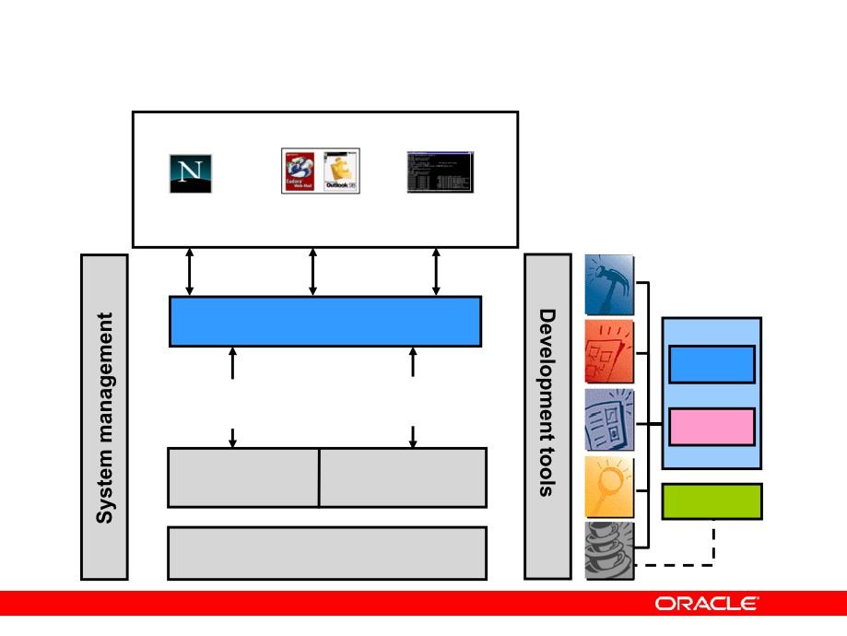
Oracle Internet Platform
Clients
Any
Any
Any
browser
mail client
FTP client
Internet applications
SQL
Business logic Presentation and
and data business logic
PL/SQL
Databases
Application servers
Java
Network services
Copyright © 2004, Oracle. All rights reserved.

Slide 13
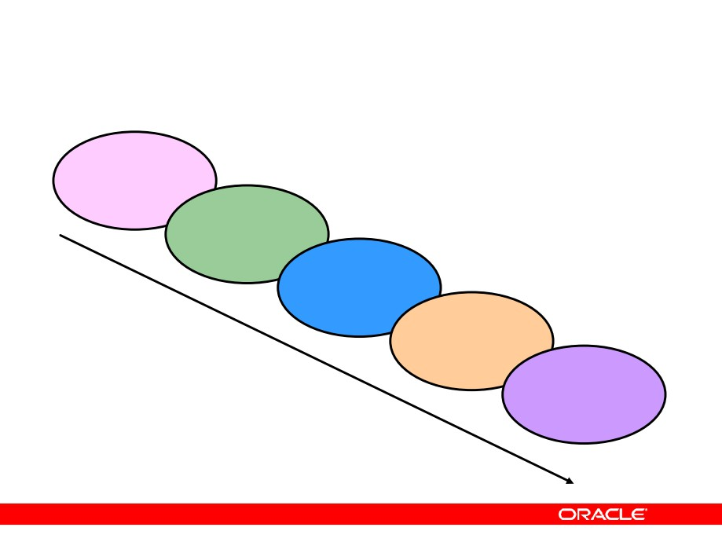
System Development Life Cycle
Strategy
and
analysis
Design
Build and
document
Transition
Production
Copyright © 2004, Oracle. All rights reserved.

Slide 14
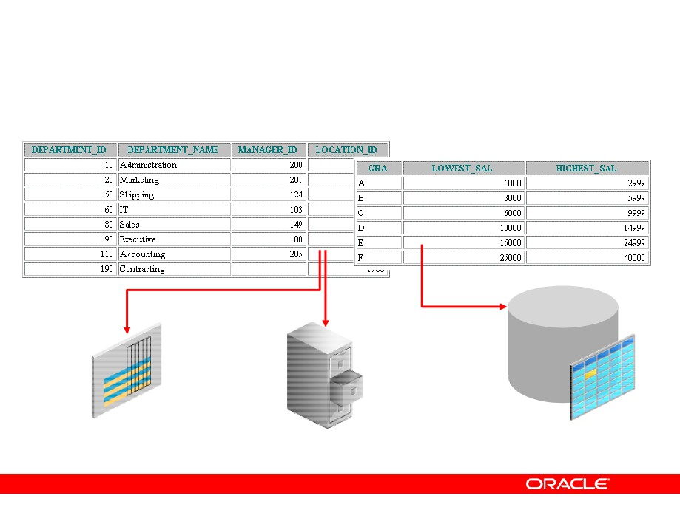
Data Storage on Different Media
Electronic
Database
spreadsheet
Filing cabinet
Copyright © 2004, Oracle. All rights reserved.

Slide 15
Relational Database Concept
• Dr. E. F. Codd proposed the relational model for
database systems in 1970.
• It is the basis for the relational database
management system (RDBMS).
• The relational model consists of the following:
- Collection of objects or relations
- Set of operators to act on the relations
- Data integrity for accuracy and consistency
Copyright © 2004, Oracle. All rights reserved.

Slide 16
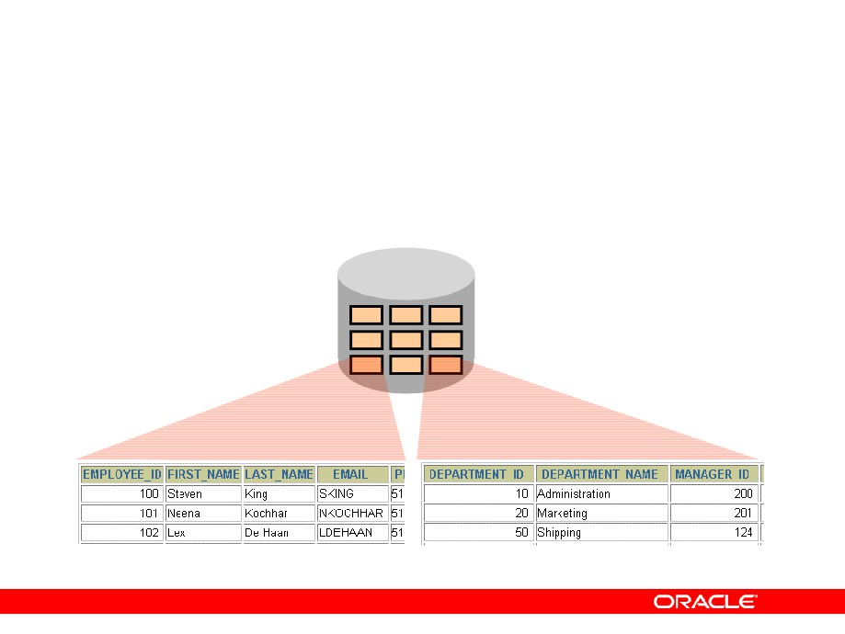
Definition of a Relational Database
A relational database is a collection of relations or two-dimensional tables.
Oracle
server
Table name: EMPLOYEES Table name: DEPARTMENTS
Copyright © 2004, Oracle. All rights reserved.

Slide 17
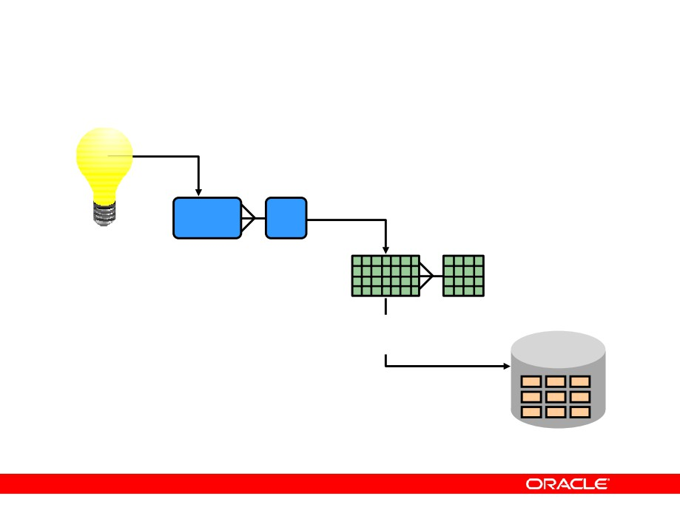
Data Models
Model of
system
Entity model of client’s model
in client’s mind
Table model of entity model
Oracle
server
Tables on disk
Copyright © 2004, Oracle. All rights reserved.

Slide 18
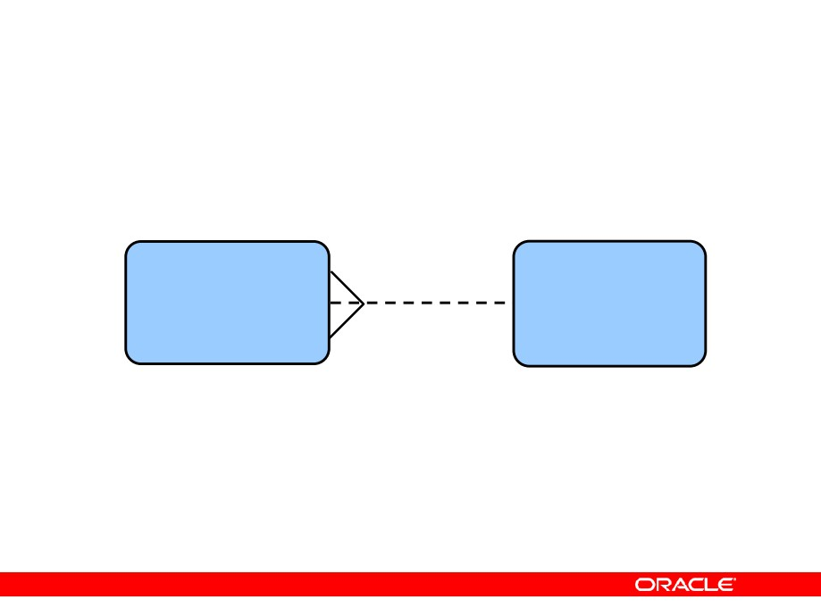
Entity Relationship Model
• Create an entity relationship diagram from
business specifications or narratives:
EMPLOYEE DEPARTMENT
#* number
assigned to
#* number
name
* name
o job title
composed of
o location
• Scenario
-
“. . . Assign one or more employees to a
department . . .”
- “. . . Some departments do not yet have assigned
employees . . .”
Copyright © 2004, Oracle. All rights reserved.

Slide 19
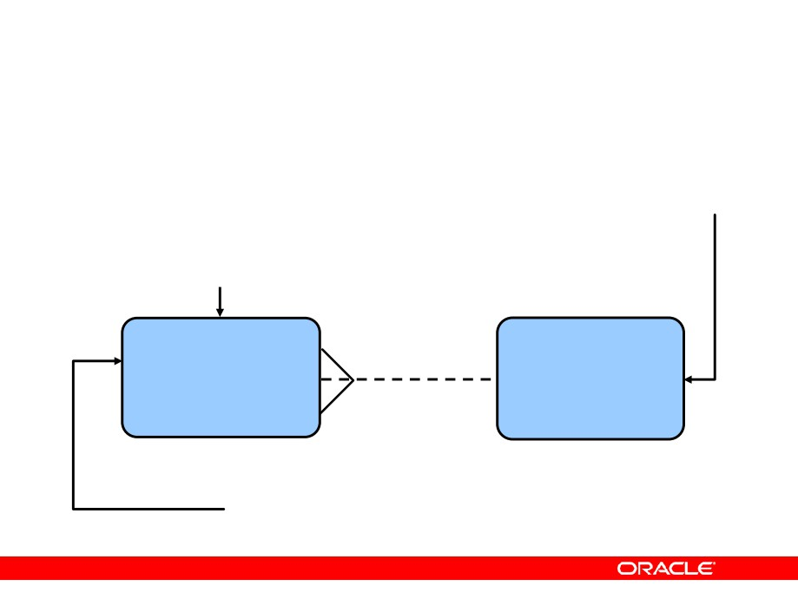
Entity Relationship Modeling Conventions
Entity
Attribute
•
Singular, unique name
•
Singular name
•
Uppercase
•
Lowercase
•
Soft box
•
Mandatory marked with *
•
Synonym in parentheses
•
Optional marked with “o”
EMPLOYEE DEPARTMENT
#*
assigned to number
#* number
name
* name
o
composed of job title
o location
Unique identifier (UID)
Primary marked with “#” Secondary marked with “(#)”
Copyright © 2004, Oracle. All rights reserved.

Slide 20
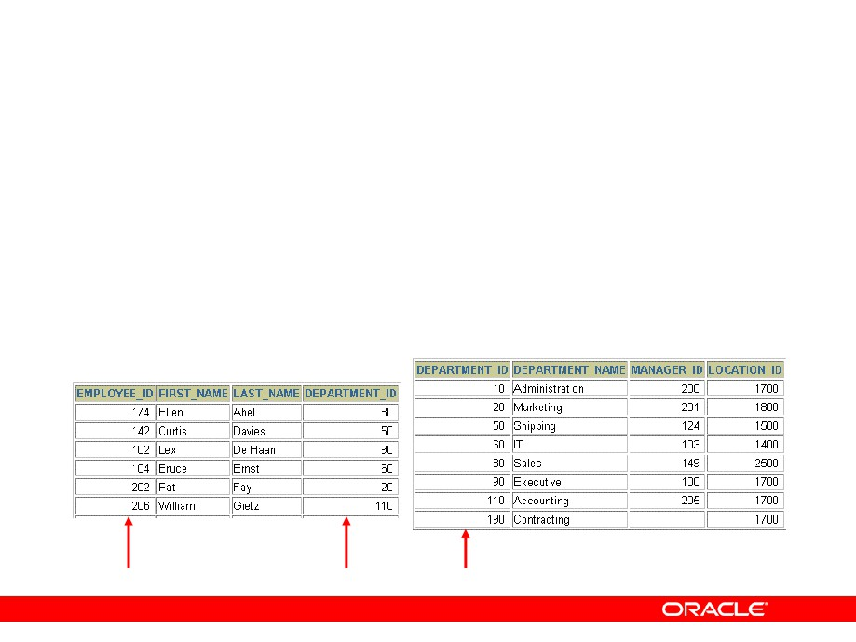
Relating Multiple Tables
• Each row of data in a table is uniquely identified
by a primary key (PK).
• You can logically relate data from multiple tables
using foreign keys (FK).
Table name: DEPARTMENTS
Table name: EMPLOYEES
…
Primary key
Foreign key Primary key
Copyright © 2004, Oracle. All rights reserved.

Slide 21
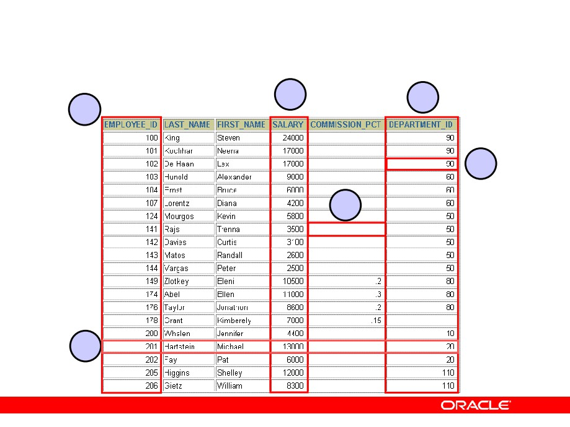
Relational Database Terminology
3 4
2
5
6
1
Copyright © 2004, Oracle. All rights reserved.

Slide 22
Relational Database Properties
A relational database:
• Can be accessed and modified by executing
structured query language (SQL) statements
• Contains a collection of tables with no physical
pointers
•
Uses a set of operators
Copyright © 2004, Oracle. All rights reserved.

Slide 23
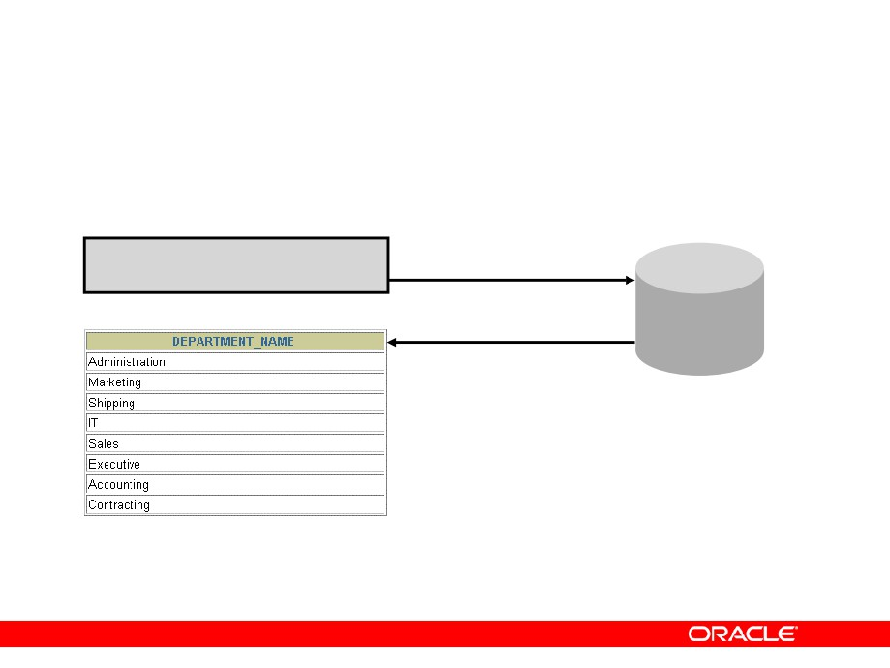
Communicating with an RDBMS Using SQL
SQL statement is entered. Statement is sent to
Oracle server.
SELECT department_name
FROM
departments;
Oracle server
Copyright © 2004, Oracle. All rights reserved.

Slide 24
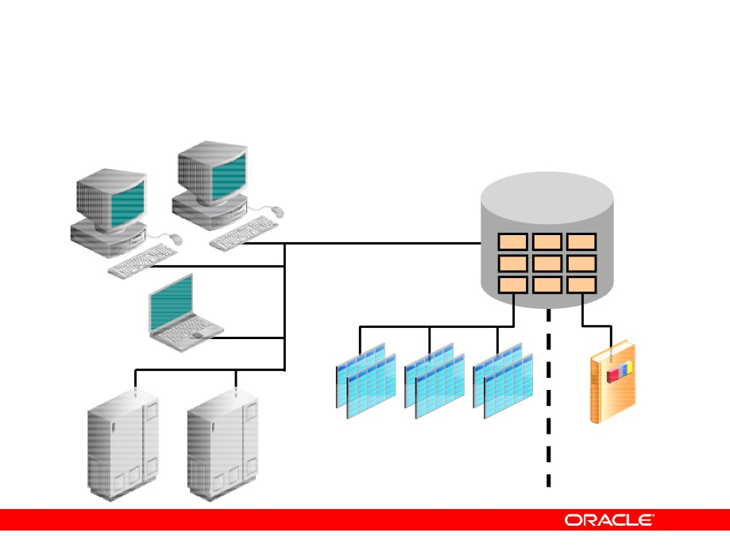
Oracle’s Relational Database Management System
Oracle
server
User tables
Data dictionary
Copyright © 2004, Oracle. All rights reserved.

Slide 25
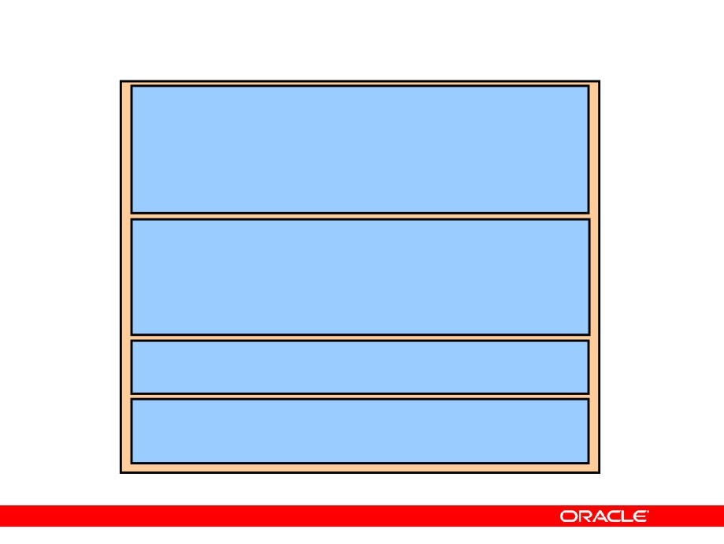
SQL Statements
SELECT
INSERT
UPDATE
Data manipulation language (DML)
DELETE
MERGE
CREATE
ALTER
DROP
Data definition language (DDL)
RENAME
TRUNCATE
COMMENT
GRANT
Data control language (DCL)
REVOKE
COMMIT
ROLLBACK
Transaction control
SAVEPOINT
Copyright © 2004, Oracle. All rights reserved.

Slide 26
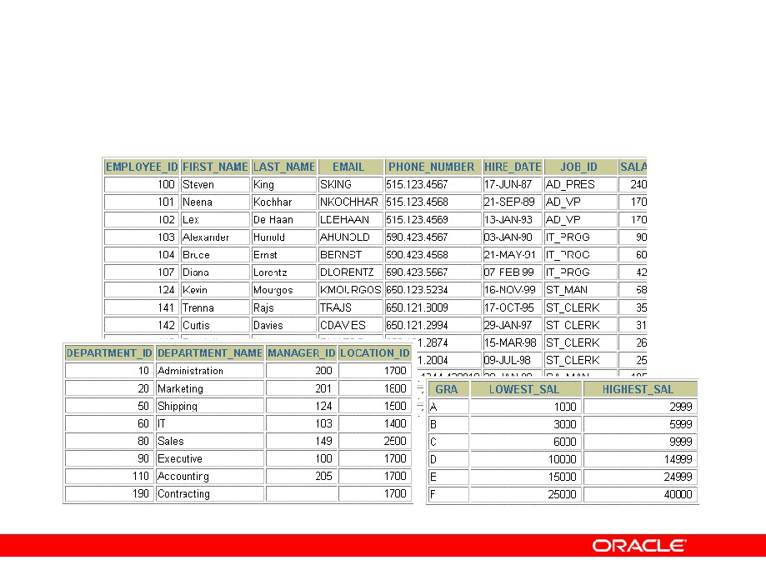
Tables Used in the Course
EMPLOYEES
DEPARTMENTS
JOB_GRADES
Copyright © 2004, Oracle. All rights reserved.

Slide 27
Summary
• Oracle Database 10g is the database for grid
computing.
• The database is based on the object relational
database management system.
• Relational databases are composed of relations,
managed by relational operations, and governed by data integrity constraints.
• With the Oracle server, you can store and manage
information by using the SQL language and PL/SQL engine.
Copyright © 2004, Oracle. All rights reserved.

Slide 28

Retrieving Data Using
the SQL SELECT Statement
Copyright © 2004, Oracle. All rights reserved.

Slide 29
Objectives
After completing this lesson, you should be able to do the following:
•
List the capabilities of SQL SELECT statements
•
Execute a basic SELECT statement
•
Differentiate between SQL statements and
iSQL*Plus commands
Copyright © 2004, Oracle. All rights reserved.

Slide 30
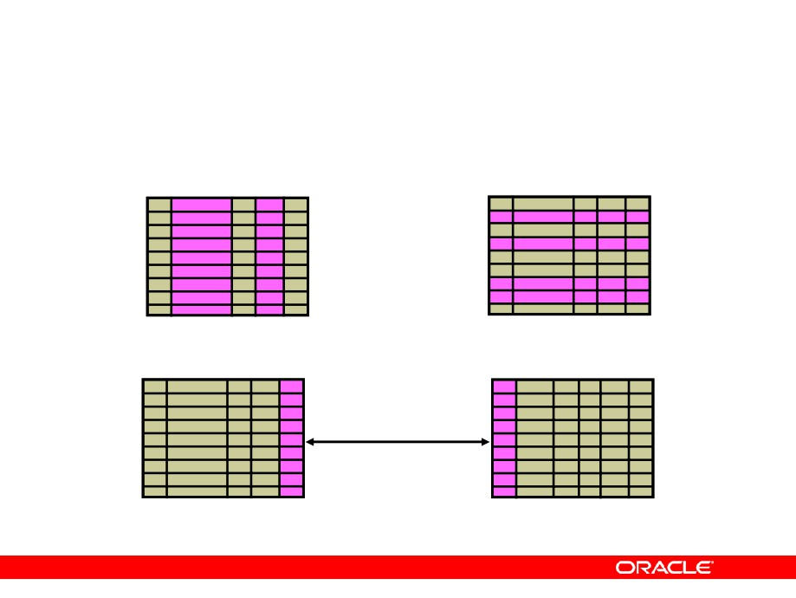
Capabilities of SQL SELECT Statements
Projection
Selection
Table 1
Table 1
Join
Table 1
Table 2
Copyright © 2004, Oracle. All rights reserved.

Slide 31
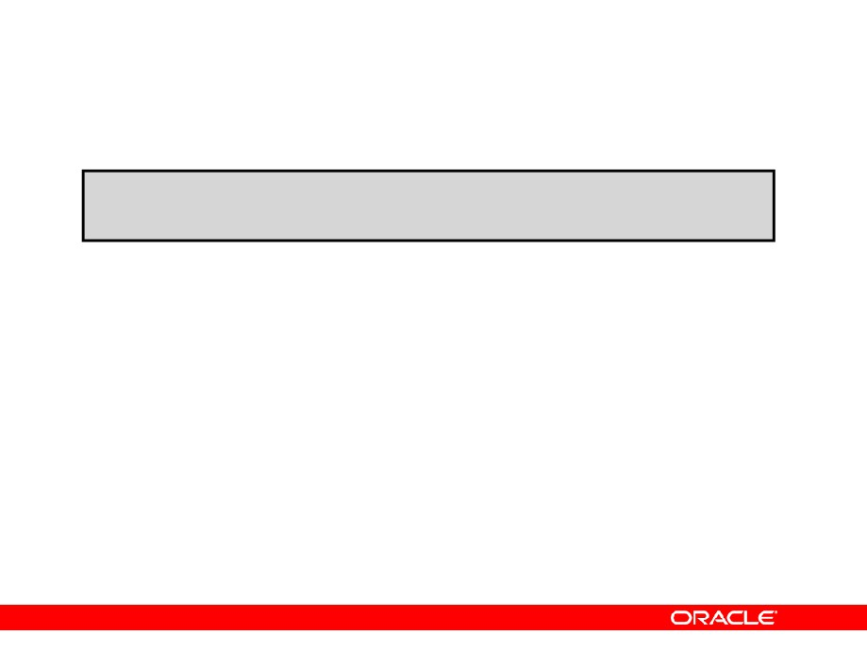
Basic SELECT Statement
SELECT *|{[DISTINCT] column|expression [alias],...}
FROM
table;
•
SELECT identifies the columns to be displayed
•
FROM identifies the table containing those columns
Copyright © 2004, Oracle. All rights reserved.

Slide 32
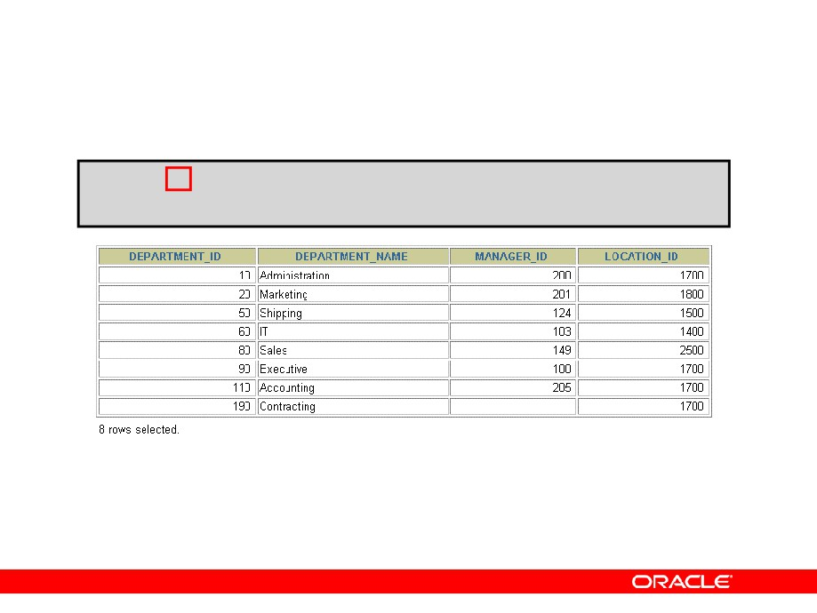
Selecting All Columns
SELECT
FROM
departments;
Copyright © 2004, Oracle. All rights reserved.

Slide 33
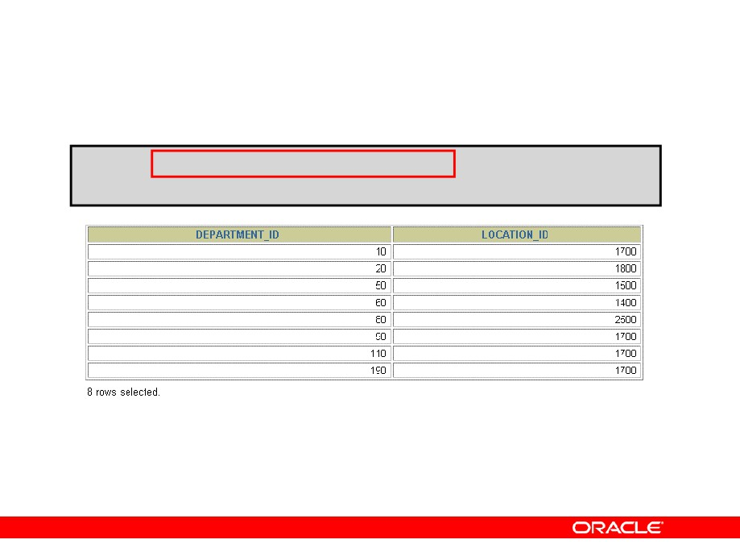
Selecting Specific Columns
SELECT
department_id, location_id
FROM
departments;
Copyright © 2004, Oracle. All rights reserved.

Slide 34
Writing SQL Statements
•
SQL statements are not case-sensitive.
•
SQL statements can be on one or more lines.
•
Keywords cannot be abbreviated or split
across lines.
•
Clauses are usually placed on separate lines.
•
Indents are used to enhance readability.
•
In iSQL*Plus, SQL statements can optionally be
terminated by a semicolon (;). Semicolons are
required if you execute multiple SQL statements.
• In SQL*plus, you are required to end each SQL
statement with a semicolon (;).
Copyright © 2004, Oracle. All rights reserved.

Slide 35
Column Heading Defaults
•
iSQL*Plus:
- Default heading alignment: Center
- Default heading display: Uppercase
•
SQL*Plus:
- Character and Date column headings are left- aligned
- Number column headings are right-aligned
- Default heading display: Uppercase
Copyright © 2004, Oracle. All rights reserved.

Slide 36
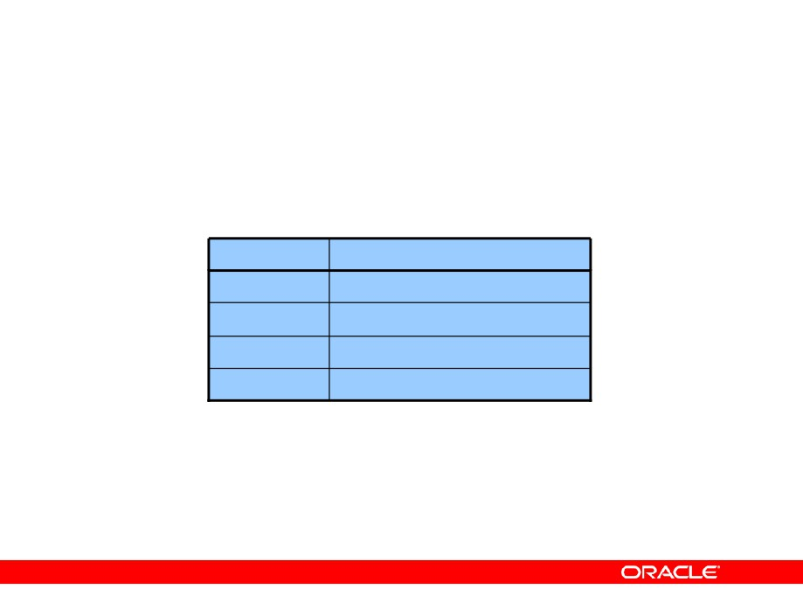
Arithmetic Expressions
Create expressions with number and date data by using arithmetic operators.
Operator
Description
+
Add
-
Subtract
*
Multiply
/
Divide
Copyright © 2004, Oracle. All rights reserved.

Slide 37
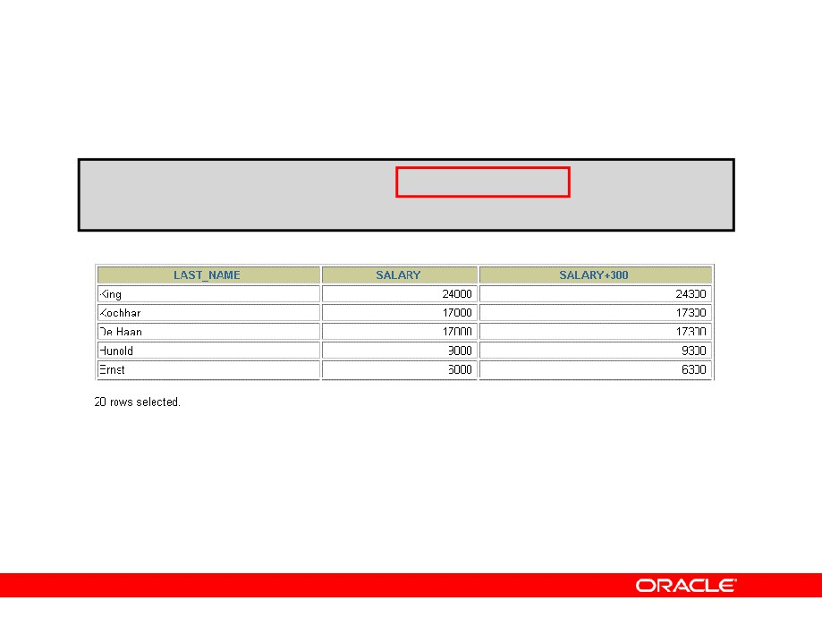
Using Arithmetic Operators
SELECT last_name, salary, salary + 300
FROM
employees;
Copyright © 2004, Oracle. All rights reserved.

Slide 38
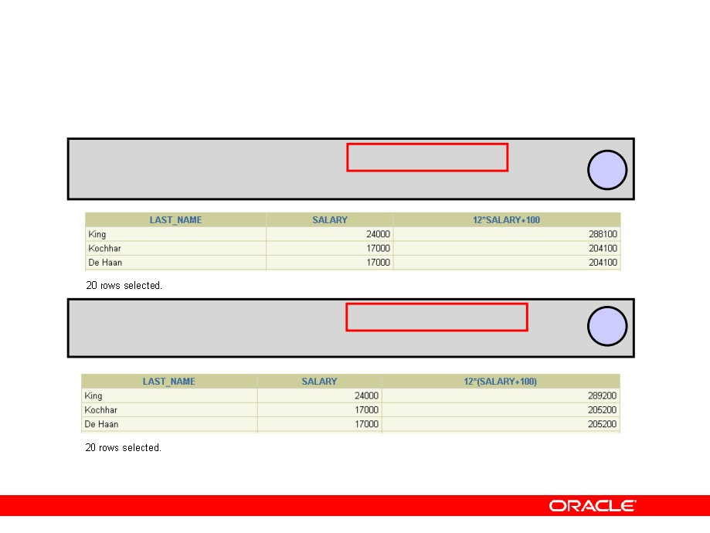
Operator Precedence
SELECT last_name, salary, FROM employees;
12*salary+100
1
SELECT last_name, salary, FROM employees;
12*(salary+100)
2
…
Copyright © 2004, Oracle. All rights reserved.

Slide 39
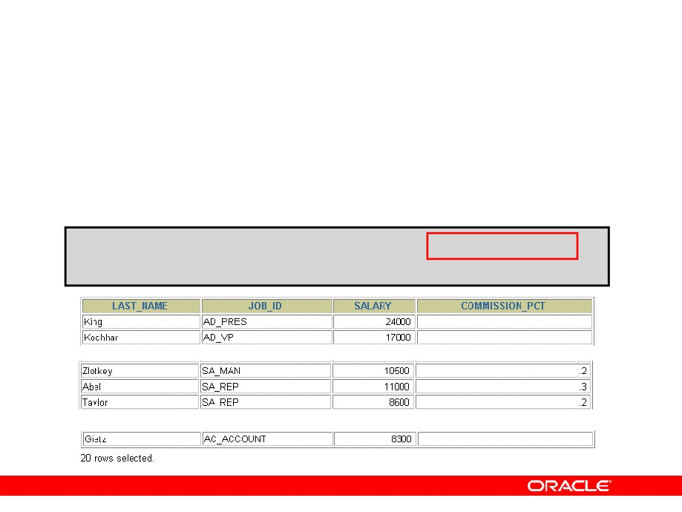
Defining a Null Value
• A null is a value that is unavailable, unassigned,
unknown, or inapplicable.
• A null is not the same as a zero or a blank space.
SELECT last_name, job_id, salary, commission_pct
FROM
employees;
…
Copyright © 2004, Oracle. All rights reserved.

Slide 40
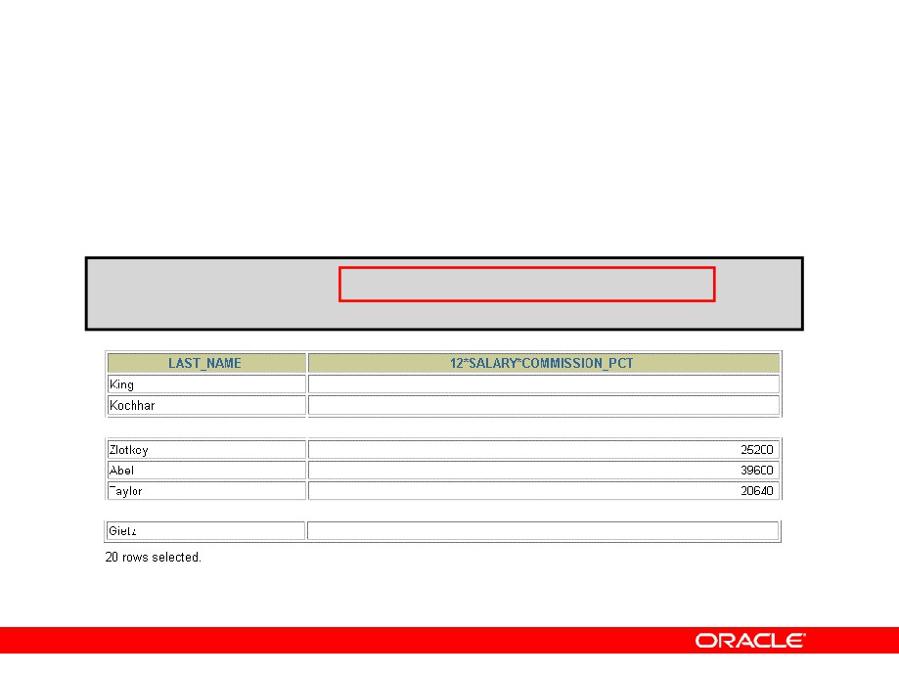
Null Values
in Arithmetic Expressions
Arithmetic expressions containing a null value evaluate to null.
SELECT last_name, 12*salary*commission_pct
FROM
employees;
Copyright © 2004, Oracle. All rights reserved.

Slide 41
Defining a Column Alias
A column alias:
•
Renames a column heading
•
Is useful with calculations
•
Immediately follows the column name (There can
also be the optional AS keyword between the column name and alias.)
• Requires double quotation marks if it contains
spaces or special characters or if it is case- sensitive
Copyright © 2004, Oracle. All rights reserved.

Slide 42
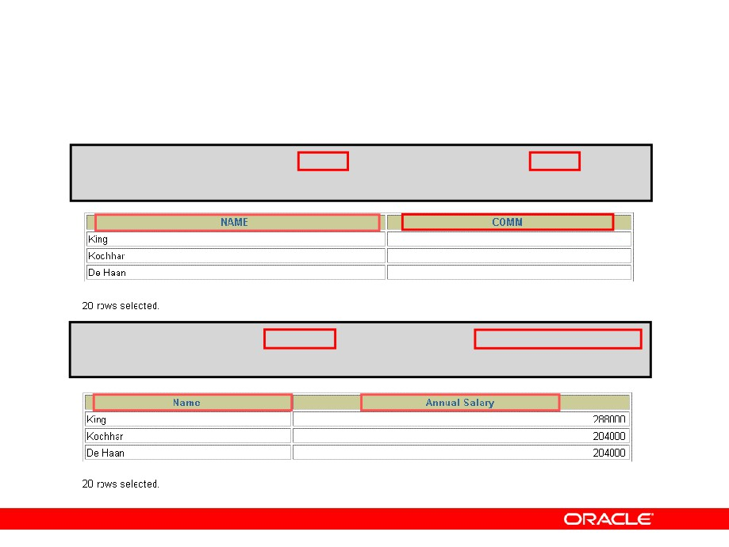
Using Column Aliases
SELECT last_name AS
name, commission_pct
comm
FROM
employees;
…
SELECT last_name
"Name"
, salary*12
"Annual Salary"
FROM
employees;
…
Copyright © 2004, Oracle. All rights reserved.

Slide 43
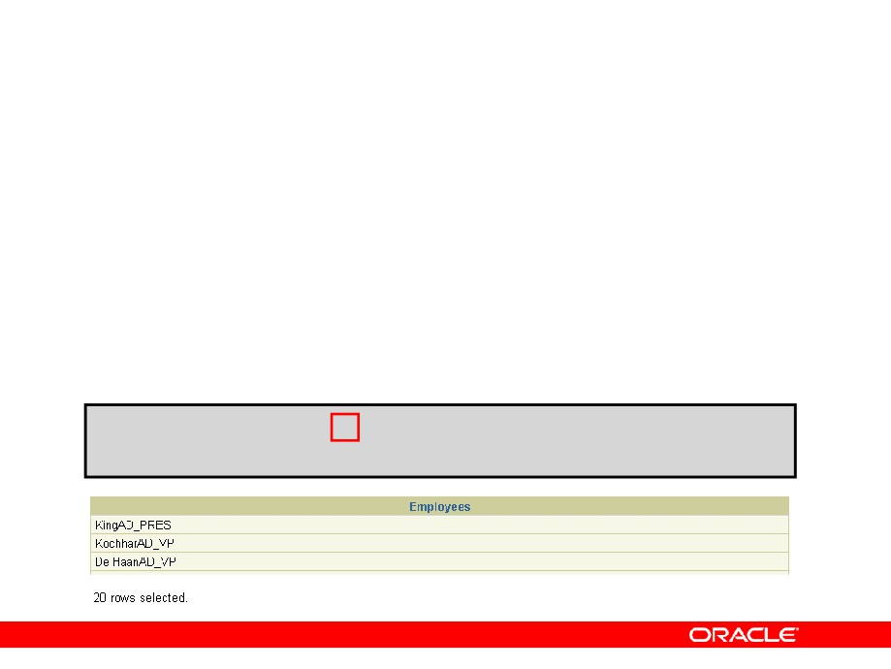
Concatenation Operator
A concatenation operator:
•
Links columns or character strings to other
columns
•
Is represented by two vertical bars (||)
•
Creates a resultant column that is a character
expression
SELECT
last_name||job_id AS "Employees"
FROM
employees;
Copyright © 2004, Oracle. All rights reserved.

Slide 44
Literal Character Strings
• A literal is a character, a number, or a date that is
included in the SELECT statement.
• Date and character literal values must be enclosed
by single quotation marks.
• Each character string is output once for each
row returned.
Copyright © 2004, Oracle. All rights reserved.

Slide 45
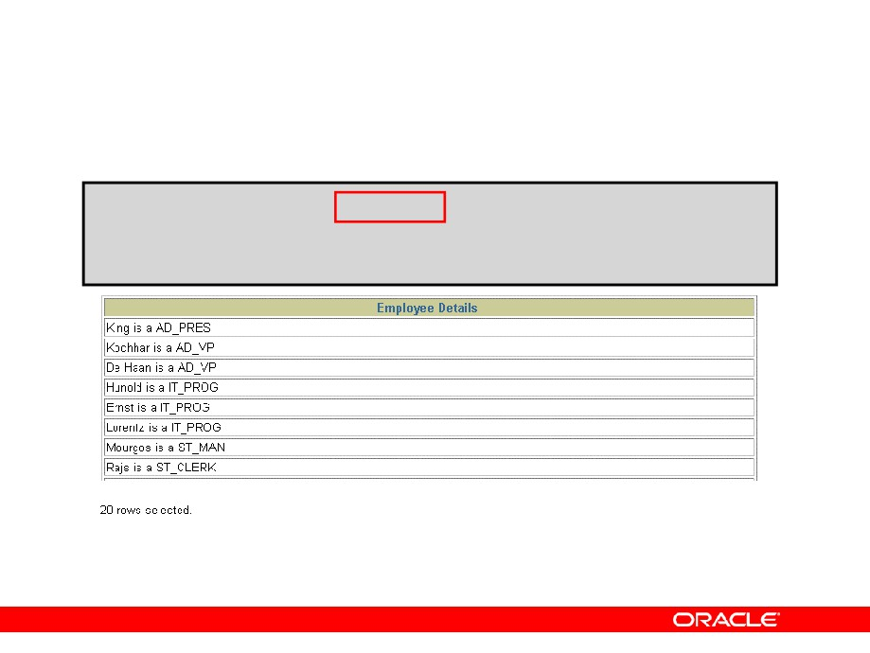
Using Literal Character Strings
SELECT last_name ||' is a '||job_id AS "Employee Details"
FROM
employees;
Copyright © 2004, Oracle. All rights reserved.

Slide 46
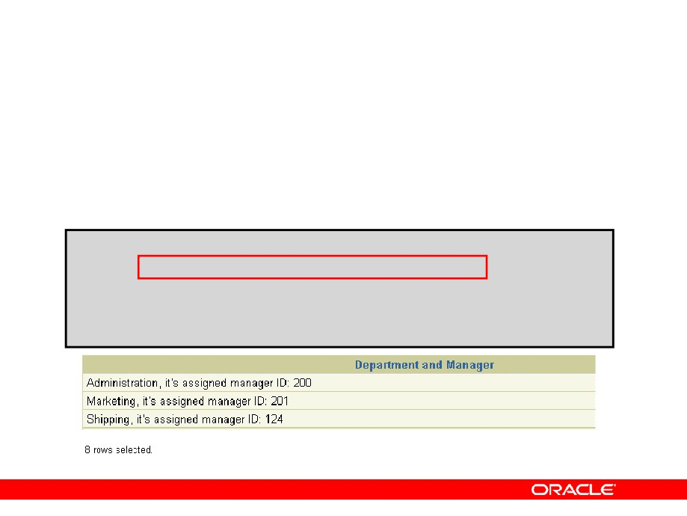
Alternative Quote (q) Operator
•
Specify your own quotation mark delimiter
•
Choose any delimiter
•
Increase readability and usability
SELECT department_name ||
q'[, it's assigned Manager Id: ]' || manager_id
AS "Department and Manager" FROM departments;
…
Copyright © 2004, Oracle. All rights reserved.

Slide 47
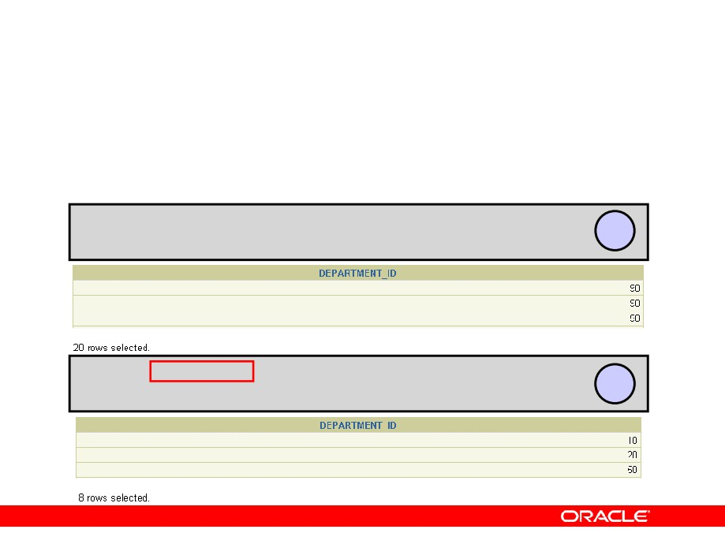
Duplicate Rows
The default display of queries is all rows, including duplicate rows.
SELECT department_id FROM employees;
1
SELECT DISTINCT department_id FROM employees;
2
…
Copyright © 2004, Oracle. All rights reserved.

Slide 48
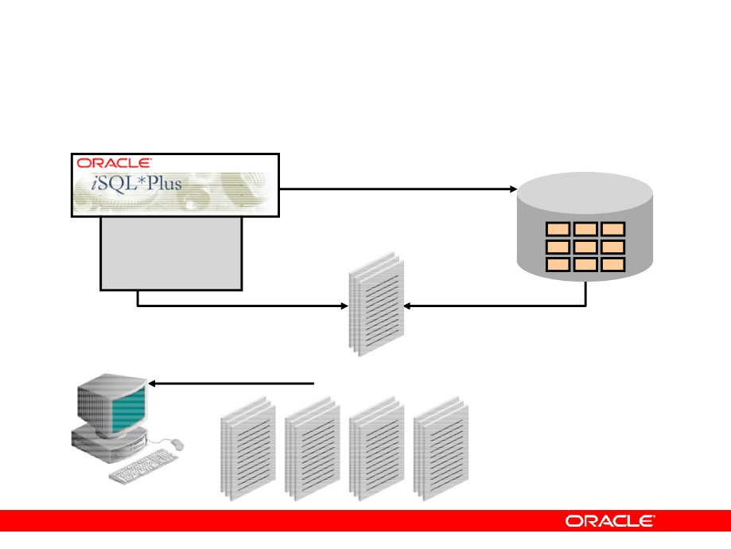
SQL and iSQL*Plus Interaction
SQL statements
Oracle
server
Internet
browser
iSQL*Plus
Query results
commands
Formatted report
Client
Copyright © 2004, Oracle. All rights reserved.

Slide 49
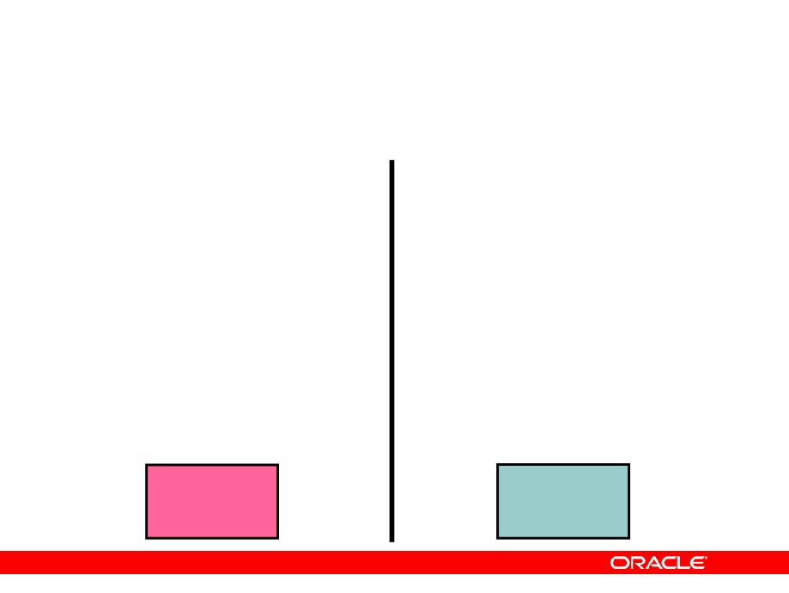
SQL Statements Versus iSQL*Plus Commands
SQL
iSQL*Plus
• A language
• An environment
• ANSI standard
• Oracle-proprietary
• Keyword cannot be
• Keywords can be
abbreviated
abbreviated
• Statements manipulate data and table definitions
• Commands do not allow manipulation of values in
in the database
the database
• Runs on a browser
• Centrally loaded; does not have to be implemented
on each machine
SQL statements
iSQL*Plus
commands
Copyright © 2004, Oracle. All rights reserved.

Slide 50
Overview of iSQL*Plus
After you log in to iSQL*Plus, you can:
•
Describe table structures
•
Enter, execute, and edit SQL statements
•
Save or append SQL statements to files
•
Execute or edit statements that are stored in
saved script files
Copyright © 2004, Oracle. All rights reserved.

Slide 51
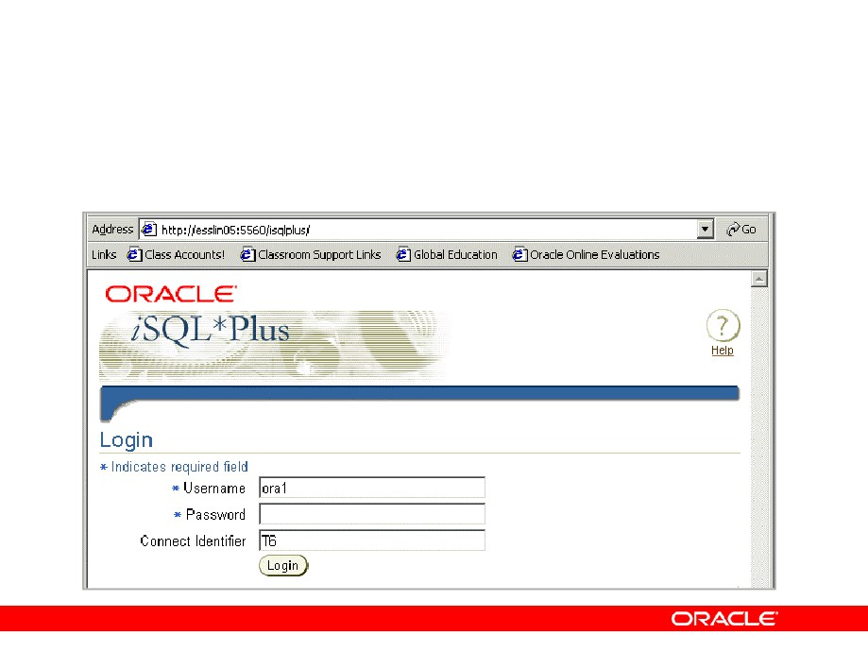
Logging In to iSQL*Plus
From your browser environment:
Copyright © 2004, Oracle. All rights reserved.

Slide 52
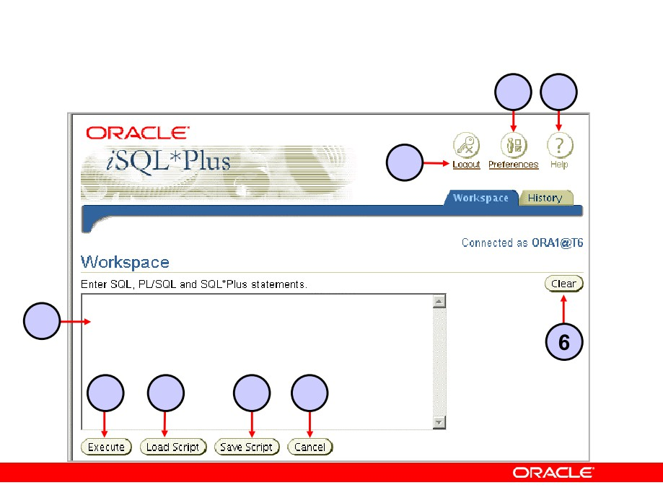
iSQL*Plus Environment
8
9
7
1
2
3
4
5
Copyright © 2004, Oracle. All rights reserved.

Slide 53
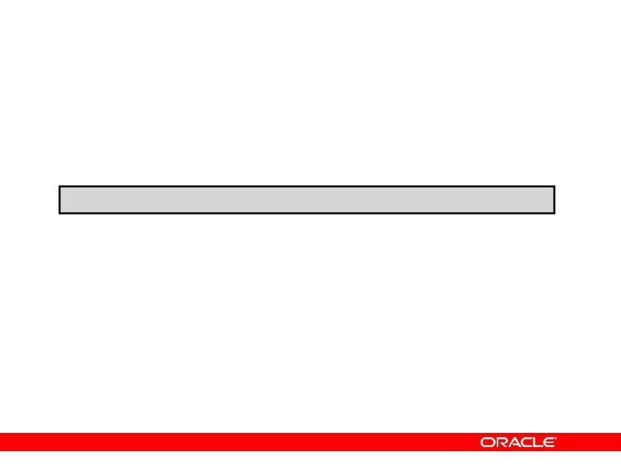
Displaying Table Structure
Use the iSQL*Plus DESCRIBE command to display the structure of a table:
DESC[RIBE] tablename
Copyright © 2004, Oracle. All rights reserved.

Slide 54
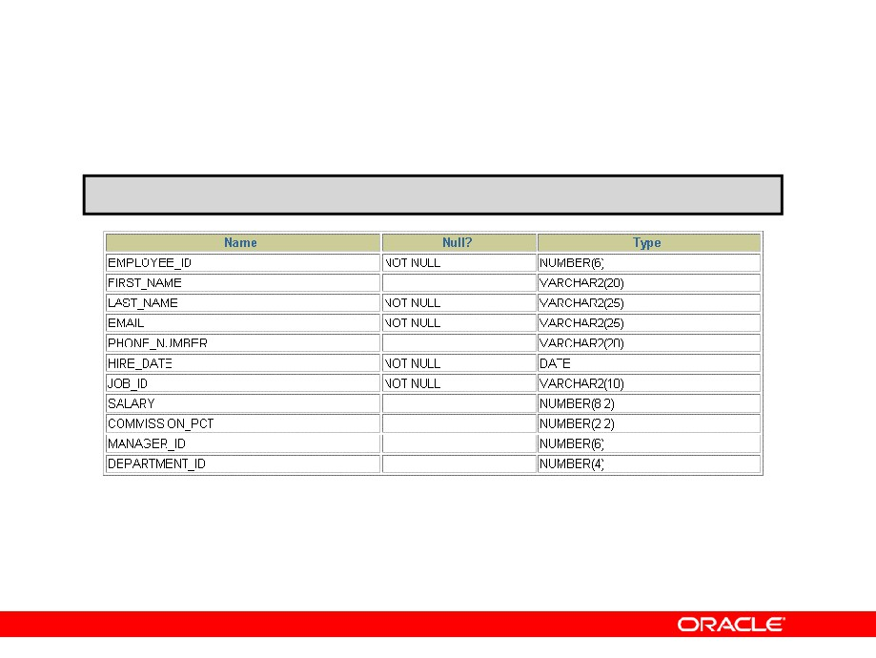
Displaying Table Structure
DESCRIBE employees
Copyright © 2004, Oracle. All rights reserved.

Slide 55
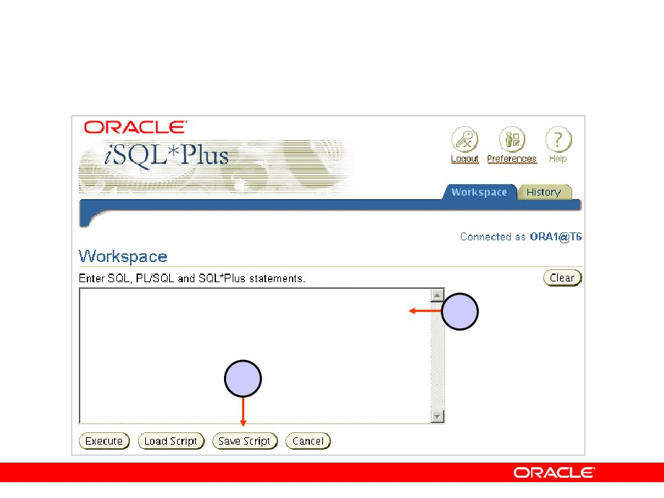
Interacting with Script Files
SELECT last_name, hire_date, salary FROM employees;
1
2
Copyright © 2004, Oracle. All rights reserved.

Slide 56
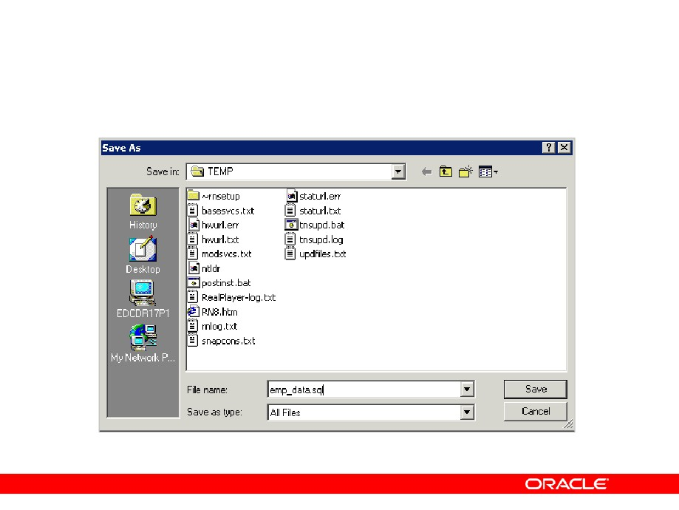
Interacting with Script Files
Copyright © 2004, Oracle. All rights reserved.

Slide 57
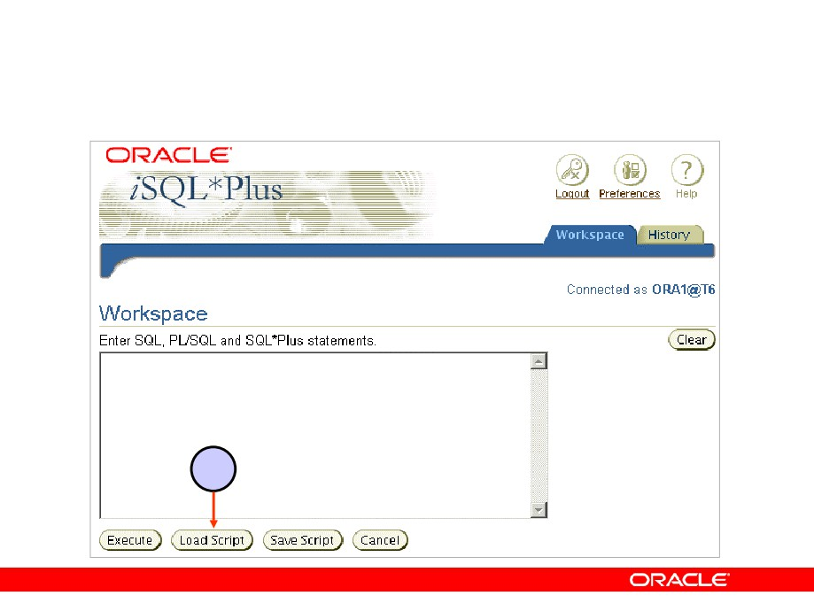
Interacting with Script Files
1
Copyright © 2004, Oracle. All rights reserved.

Slide 58
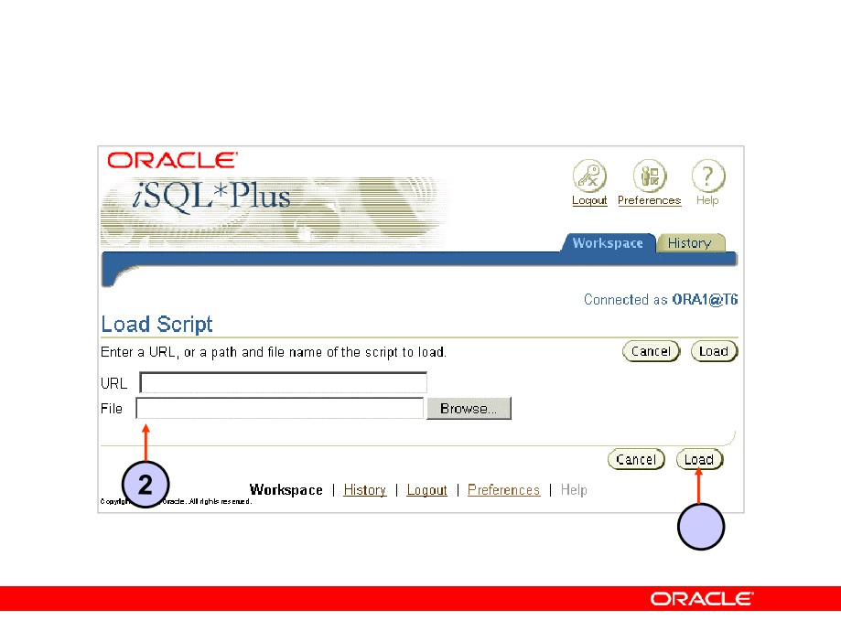
Interacting with Script Files
D:\TEMP\emp_data.sql
3
Copyright © 2004, Oracle. All rights reserved.

Slide 59
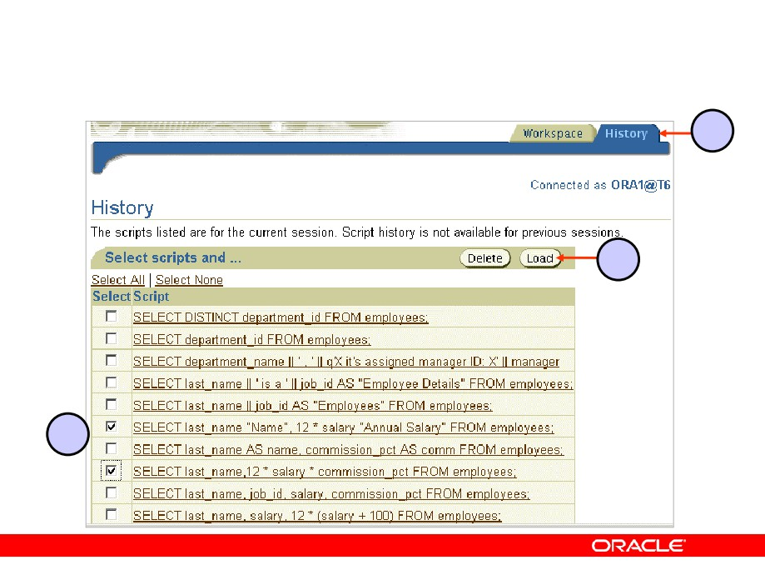
iSQL*Plus History Page
3
2
1
Copyright © 2004, Oracle. All rights reserved.

Slide 60
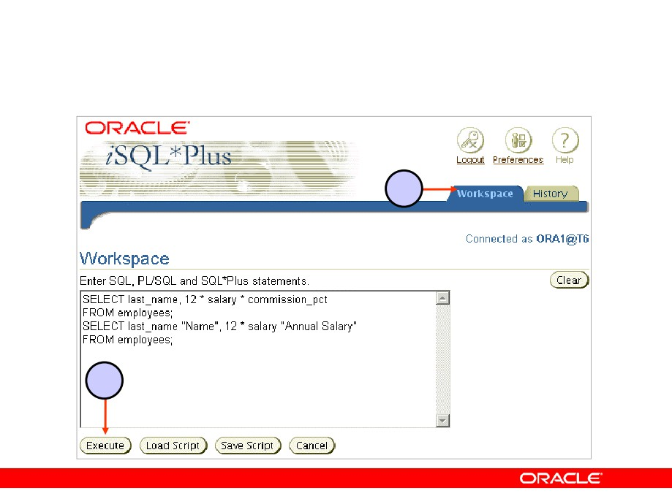
iSQL*Plus History Page
3
4
Copyright © 2004, Oracle. All rights reserved.

Slide 61
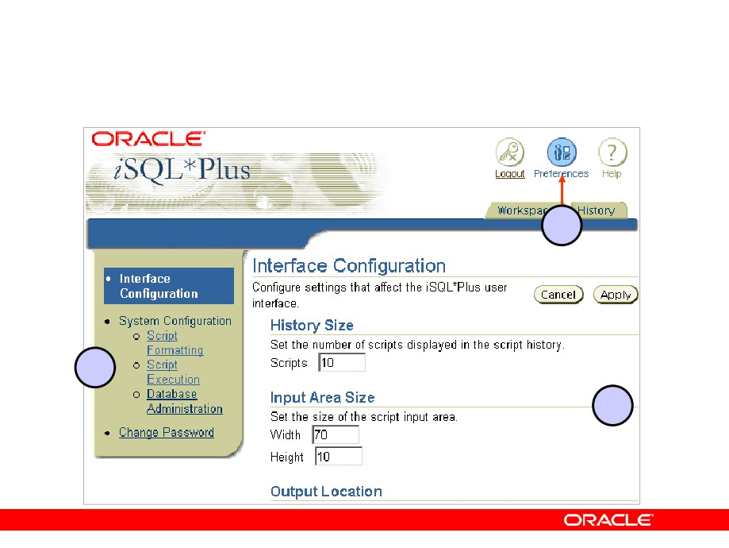
Setting iSQL*Plus Preferences
1
2
3
Copyright © 2004, Oracle. All rights reserved.

Slide 62
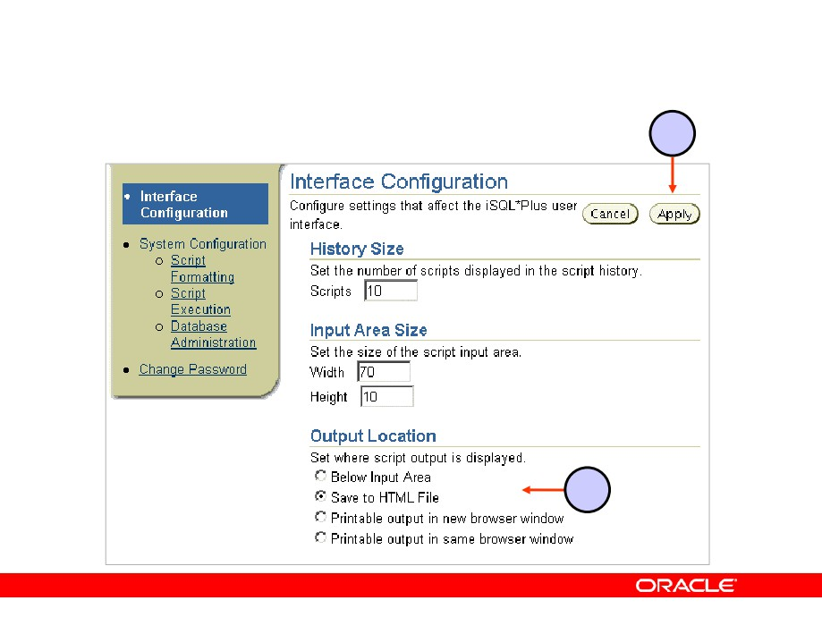
Setting the Output Location Preference
2
1
Copyright © 2004, Oracle. All rights reserved.

Slide 63
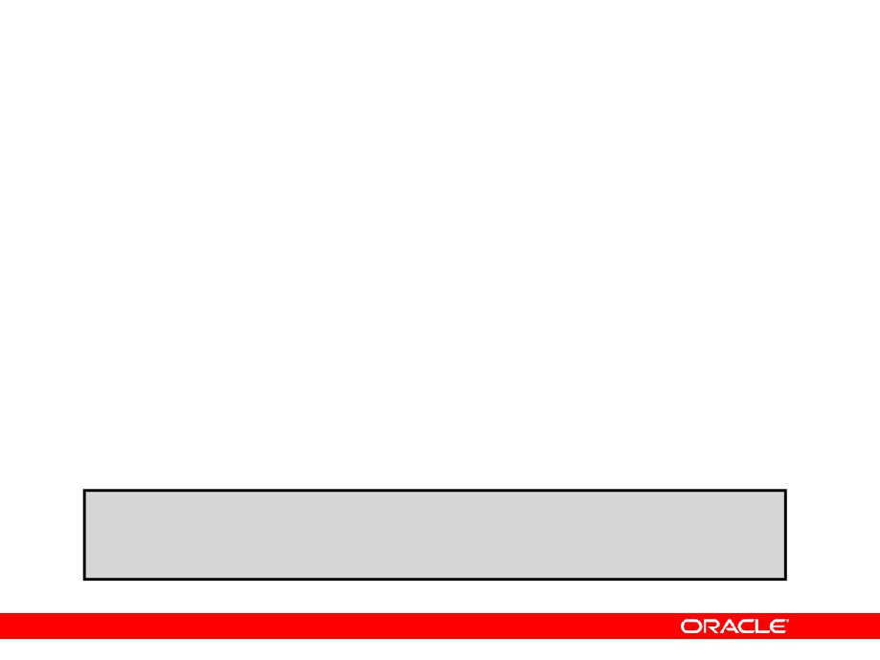
Summary
In this lesson, you should have learned how to:
• Write a SELECT statement that:
- Returns all rows and columns from a table
- Returns specified columns from a table
- Uses column aliases to display more descriptive column headings
• Use the iSQL*Plus environment to write, save, and
execute SQL statements and iSQL*Plus commands
SELECT *|{[DISTINCT] column|expression [alias],...} FROM table;
Copyright © 2004, Oracle. All rights reserved.

Slide 64
Practice 1: Overview
This practice covers the following topics:
•
Selecting all data from different tables
•
Describing the structure of tables
•
Performing arithmetic calculations and specifying
column names
•
Using iSQL*Plus
Copyright © 2004, Oracle. All rights reserved.

Slide 65

Restricting and Sorting Data
Copyright © 2004, Oracle. All rights reserved.

Slide 66
Objectives
After completing this lesson, you should be able to do the following:
•
Limit the rows that are retrieved by a query
•
Sort the rows that are retrieved by a query
•
Use ampersand substitution in iSQL*Plus to
restrict and sort output at run time
Copyright © 2004, Oracle. All rights reserved.

Slide 67
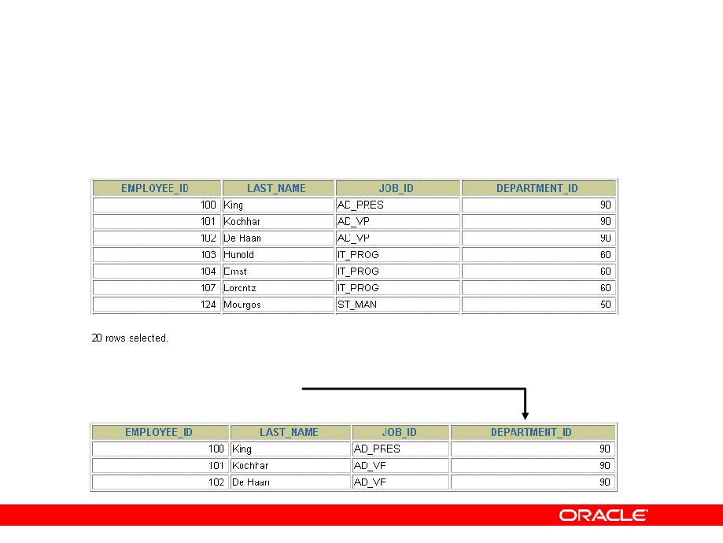
Limiting Rows Using a Selection
EMPLOYEES
“retrieve all employees in department 90”
Copyright © 2004, Oracle. All rights reserved.

Slide 68
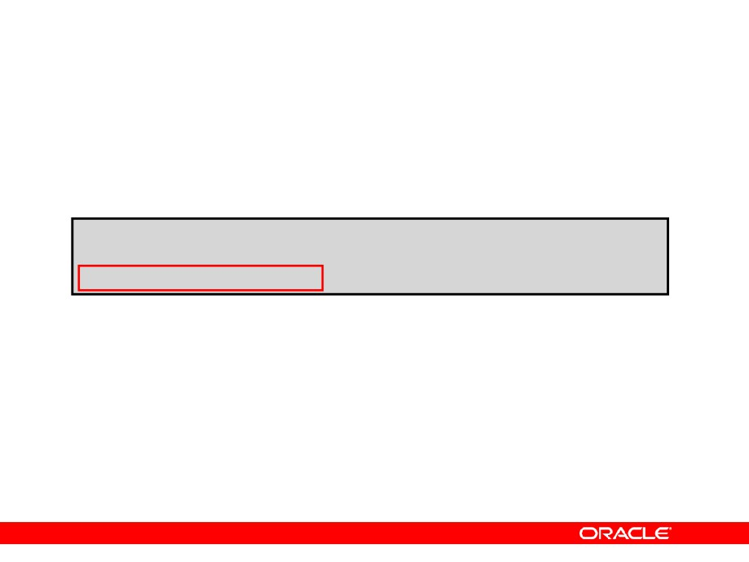
Limiting the Rows That Are Selected
• Restrict the rows that are returned by using the
WHERE clause:
SELECT *|{[DISTINCT] column|expression [alias],...} FROM table
[WHERE condition(s)];
• The WHERE clause follows the FROM clause.
Copyright © 2004, Oracle. All rights reserved.

Slide 69
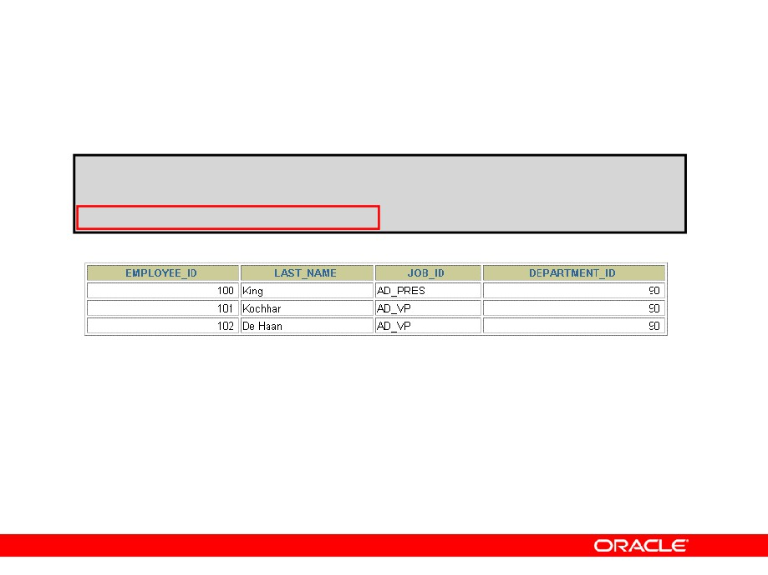
Using the WHERE Clause
SELECT employee_id, last_name, job_id, department_id
FROM
employees
WHERE
department_id = 90
;
Copyright © 2004, Oracle. All rights reserved.

Slide 70
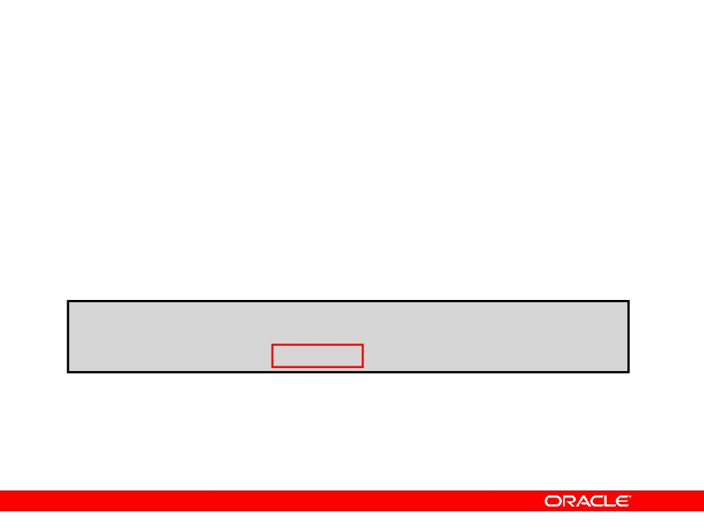
Character Strings and Dates
• Character strings and date values are enclosed by
single quotation marks.
• Character values are case-sensitive, and date
values are format-sensitive.
•
The default date format is DD-MON-RR.
SELECT last_name, job_id, department_id
FROM
employees
WHERE
last_name =
'Whalen'
;
Copyright © 2004, Oracle. All rights reserved.

Slide 71

Comparison Conditions
Operator
Meaning
=
Equal to
>
Greater than
>=
Greater than or equal to
<
Less than
<=
Less than or equal to
<>
Not equal to
BETWEEN
Between two values
...AND...
(inclusive)
IN(set)
Match any of a list of values
LIKE
Match a character pattern
IS NULL
Is a null value
Copyright © 2004, Oracle. All rights reserved.

Slide 72

Using Comparison Conditions
SELECT last_name, salary
FROM
employees
WHERE
salary
<= 3000
;
Copyright © 2004, Oracle. All rights reserved.

Slide 73

Using the BETWEEN Condition
Use the BETWEEN condition to display rows based on a range of values:
SELECT last_name, salary
FROM
employees
WHERE
salary BETWEEN 2500 AND 3500
;
Lower limit
Upper limit
Copyright © 2004, Oracle. All rights reserved.

Slide 74

Using the IN Condition
Use the IN membership condition to test for values in a list:
SELECT employee_id, last_name, salary, manager_id
FROM
employees
WHERE
manager_id
IN (100, 101, 201) ;
Copyright © 2004, Oracle. All rights reserved.

Slide 75

Using the LIKE Condition
• Use the LIKE condition to perform wildcard
searches of valid search string values.
•
Search conditions can contain either literal
characters or numbers:
-
% denotes zero or many characters.
–
_ denotes one character.
SELECT
first_name
FROM
employees
WHERE
first_name
LIKE 'S%'
;
Copyright © 2004, Oracle. All rights reserved.

Slide 76

Using the LIKE Condition
•
You can combine pattern-matching characters:
SELECT last_name
FROM
employees
WHERE
last_name
LIKE '_o%' ;
• You can use the ESCAPE identifier to search for the
actual % and _ symbols.
Copyright © 2004, Oracle. All rights reserved.

Slide 77

Using the NULL Conditions
Test for nulls with the IS NULL operator.
SELECT last_name, manager_id
FROM
employees
WHERE
manager_id IS NULL
;
Copyright © 2004, Oracle. All rights reserved.

Slide 78

Logical Conditions
Operator
Meaning
AND
Returns TRUE if both component
conditions are true
OR
Returns TRUE if either component
condition is true
NOT
Returns TRUE if the following
condition is false
Copyright © 2004, Oracle. All rights reserved.

Slide 79

Using the AND Operator
AND requires both conditions to be true:
SELECT employee_id, last_name, job_id, salary
FROM
employees
WHERE
salary >=10000
AND
job_id LIKE '%MAN%'
;
Copyright © 2004, Oracle. All rights reserved.

Slide 80

Using the OR Operator
OR requires either condition to be true:
SELECT employee_id, last_name, job_id, salary
FROM
employees
WHERE
salary >= 10000
OR
job_id LIKE '%MAN%' ;
Copyright © 2004, Oracle. All rights reserved.

Slide 81

Using the NOT Operator
SELECT last_name, job_id
FROM
employees
WHERE
job_id
NOT IN ('IT_PROG', 'ST_CLERK', 'SA_REP') ;
Copyright © 2004, Oracle. All rights reserved.

Slide 82

Rules of Precedence
Operator
Meaning
1
Arithmetic operators
2
Concatenation operator
3
Comparison conditions
4
IS [NOT] NULL, LIKE, [NOT] IN
5
[NOT] BETWEEN
6
Not equal to
7
NOT logical condition
8
AND logical condition
9
OR logical condition
You can use parentheses to override rules of precedence.
Copyright © 2004, Oracle. All rights reserved.

Slide 83

Rules of Precedence
SELECT last_name, job_id, salary
FROM
employees
WHERE
job_id = 'SA_REP'
1
OR
job_id = 'AD_PRES'
AND
salary > 15000;
SELECT last_name, job_id, salary
FROM employees
2
WHERE (job_id = 'SA_REP'
OR job_id = 'AD_PRES')
AND salary > 15000;
Copyright © 2004, Oracle. All rights reserved.

Slide 84

Using the ORDER BY Clause
• Sort retrieved rows with the ORDER BY clause:
- ASC: ascending order, default
- DESC: descending order
•
The ORDER BY clause comes last in the SELECT
statement:
SELECT
last_name, job_id, department_id, hire_date
FROM
employees
ORDER BY hire_date
;
Copyright © 2004, Oracle. All rights reserved.

Slide 85

Sorting
•
Sorting in descending order:
SELECT
last_name, job_id, department_id, hire_date
FROM
employees
ORDER BY hire_date DESC ;
1
• Sorting by column alias:
SELECT employee_id, last_name, salary*12 FROM employees
annsal
2
ORDER BY annsal ;
• Sorting by multiple columns:
SELECT last_name, department_id, salary
FROM
employees
3
ORDER BY department_id, salary DESC;
Copyright © 2004, Oracle. All rights reserved.

Slide 86

Substitution Variables
... salary = ? …
… department_id = ? … ... last_name = ? ...
I want
to query different values.
Copyright © 2004, Oracle. All rights reserved.

Slide 87
Substitution Variables
• Use iSQL*Plus substitution variables to:
- Temporarily store values with single-ampersand (&) and double-ampersand (&&) substitution
• Use substitution variables to supplement the
following:
- WHERE conditions
- ORDER BY clauses
- Column expressions
- Table names
- Entire SELECT statements
Copyright © 2004, Oracle. All rights reserved.

Slide 88

Using the & Substitution Variable
Use a variable prefixed with an ampersand (&) to prompt the user for a value:
SELECT employee_id, last_name, salary, department_id
FROM
employees
WHERE
employee_id =
&employee_num
;
Copyright © 2004, Oracle. All rights reserved.

Slide 89

Using the & Substitution Variable
1
2
Copyright © 2004, Oracle. All rights reserved.

Slide 90

Character and Date Values with Substitution Variables
Use single quotation marks for date and character values:
SELECT last_name, department_id, salary*12
FROM
employees
WHERE
job_id =
'&job_title'
;
Copyright © 2004, Oracle. All rights reserved.

Slide 91

Specifying Column Names, Expressions, and Text
SELECT employee_id, last_name, job_id,&column_name
FROM
employees
WHERE
&condition
ORDER BY
&order_column
;
salary
salary > 15000
last_name
Copyright © 2004, Oracle. All rights reserved.

Slide 92

Using the && Substitution Variable
Use the double ampersand (&&) if you want to reuse the variable value without prompting the user each time:
SELECT
employee_id, last_name, job_id,
&&column_name
FROM
employees
ORDER BY
&column_name
;
Copyright © 2004, Oracle. All rights reserved.

Slide 93

Using the iSQL*Plus DEFINE Command
• Use the iSQL*Plus DEFINE command to create and
assign a value to a variable.
• Use the iSQL*Plus UNDEFINE command to remove
a variable.
DEFINE
employee_num
= 200
SELECT employee_id, last_name, salary, department_id
FROM
employees
WHERE
employee_id =
&employee_num
;
UNDEFINE employee_num
Copyright © 2004, Oracle. All rights reserved.

Slide 94

Using the VERIFY Command
Use the VERIFY command to toggle the display of the substitution variable, both before and after iSQL*Plus replaces substitution variables with values:
SET VERIFY ON
SELECT employee_id, last_name, salary, department_id
FROM
employees
WHERE
employee_id = &employee_num;
old
3: WHERE employee_id = &employee_num
new
3: WHERE employee_id = 200
Copyright © 2004, Oracle. All rights reserved.

Slide 95

Summary
In this lesson, you should have learned how to:
•
Use the WHERE clause to restrict rows of output:
- Use the comparison conditions
- Use the BETWEEN, IN, LIKE, and NULL conditions
- Apply the logical AND, OR, and NOT operators
•
Use the ORDER BY clause to sort rows of output:
SELECT
*|{[DISTINCT] column|expression [alias],...}
FROM
table
[WHERE
condition(s)]
[ORDER BY {column, expr, alias} [ASC|DESC]] ;
• Use ampersand substitution in iSQL*Plus to
restrict and sort output at run time
Copyright © 2004, Oracle. All rights reserved.

Slide 96
Practice 2: Overview
This practice covers the following topics:
•
Selecting data and changing the order of
the rows that are displayed
•
Restricting rows by using the WHERE clause
•
Sorting rows by using the ORDER BY clause
•
Using substitution variables to add flexibility to
your SQL SELECT statements
Copyright © 2004, Oracle. All rights reserved.

Slide 97

Using Single-Row Functions to Customize Output
Copyright © 2004, Oracle. All rights reserved.

Slide 98
Objectives
After completing this lesson, you should be able to do the following:
• Describe various types of functions that are
available in SQL
• Use character, number, and date functions in
SELECT statements
• Describe the use of conversion functions
Copyright © 2004, Oracle. All rights reserved.

Slide 99

SQL Functions
Input
Output
Function
arg 1 Function performs
action
arg 2
Result value
arg n
Copyright © 2004, Oracle. All rights reserved.

Slide 100

Two Types of SQL Functions
Functions
Single-row
Multiple-row
functions
functions
Return one result
Return one result
per row
per set of rows
Copyright © 2004, Oracle. All rights reserved.

Slide 101

Single-Row Functions
Single-row functions:
•
Manipulate data items
•
Accept arguments and return one value
•
Act on each row that is returned
•
Return one result per row
•
May modify the data type
•
Can be nested
•
Accept arguments that can be a column or an
expression
function_name [(arg1, arg2,...)]
Copyright © 2004, Oracle. All rights reserved.

Slide 102

Single-Row Functions
Character
Single-row functions
General
Number
Conversion
Date
Copyright © 2004, Oracle. All rights reserved.

Slide 103

Character Functions
Character
functions
Case-manipulation
Character-manipulation
functions
functions
LOWER
CONCAT
UPPER
SUBSTR
INITCAP
LENGTH
INSTR
LPAD | RPAD TRIM
REPLACE
Copyright © 2004, Oracle. All rights reserved.

Slide 104

Case-Manipulation Functions
These functions convert case for character strings:
Function
Result
LOWER('SQL Course')
sql course
UPPER('SQL Course')
SQL COURSE
INITCAP('SQL Course')
Sql Course
Copyright © 2004, Oracle. All rights reserved.

Slide 105

Using Case-Manipulation Functions
Display the employee number, name, and department number for employee Higgins:
SELECT employee_id, last_name, department_id
FROM
employees
WHERE
last_name = 'higgins';
no rows selected
SELECT employee_id, last_name, department_id
FROM
employees
WHERE
LOWER(last_name) = 'higgins';
Copyright © 2004, Oracle. All rights reserved.

Slide 106

Character-Manipulation Functions
These functions manipulate character strings:
Function
Result
CONCAT('Hello', 'World')
HelloWorld
SUBSTR('HelloWorld',1,5)
Hello
LENGTH('HelloWorld')
10
INSTR('HelloWorld', 'W')
6
LPAD(salary,10,'*')
*****24000
RPAD(salary, 10, '*')
24000*****
REPLACE
BLACK and BLUE
('JACK and JUE','J','BL')
TRIM('H' FROM 'HelloWorld')
elloWorld
Copyright © 2004, Oracle. All rights reserved.

Slide 107

Using the Character-Manipulation Functions
1
SELECT employee_id, CONCAT(first_name, last_name) NAME,
2
job_id, LENGTH (last_name),
INSTR(last_name, 'a') "Contains 'a'?" FROM employees
3
WHERE SUBSTR(job_id, 4) = 'REP';
1
2
3
Copyright © 2004, Oracle. All rights reserved.

Slide 108

Number Functions
•
ROUND: Rounds value to specified decimal
•
TRUNC: Truncates value to specified decimal
•
MOD: Returns remainder of division
Function
Result
ROUND(45.926, 2)
45.93
TRUNC(45.926, 2)
45.92
MOD(1600, 300)
100
Copyright © 2004, Oracle. All rights reserved.

Slide 109

Using the ROUND Function
1
2
SELECT
ROUND(45.923,2), ROUND(45.923,0),
ROUND(45.923,-1)
3
FROM
DUAL;
1
2
3
DUAL is a dummy table that you can use to view results from functions and calculations.
Copyright © 2004, Oracle. All rights reserved.

Slide 110

Using the TRUNC Function
1
2
SELECT
ROUND(45.923,2), ROUND(45.923),
ROUND(45.923,-1)
3
FROM
DUAL;
1
2
3
Copyright © 2004, Oracle. All rights reserved.

Slide 111

Using the MOD Function
For all employees with job title of Sales Representative, calculate the remainder of the salary after it is divided by 5,000.
SELECT last_name, salary, MOD(salary, 5000)
FROM
employees
WHERE
job_id = 'SA_REP';
Copyright © 2004, Oracle. All rights reserved.

Slide 112

Working with Dates
• The Oracle database stores dates in an internal numeric
format: century, year, month, day, hours, minutes, and seconds.
• The default date display format is DD-MON-RR.
- Enables you to store 21st-century dates in the
20th century by specifying only the last two digits of the year
- Enables you to store 20th-century dates in the 21st century in the same way
SELECT last_name,
hire_date
FROM
employees
WHERE
hire_date < '01-FEB-88';
Copyright © 2004, Oracle. All rights reserved.

Slide 113
Working with Dates
SYSDATE is a function that returns:
•
Date
•
Time
Copyright © 2004, Oracle. All rights reserved.

Slide 114
Arithmetic with Dates
• Add or subtract a number to or from a date for a
resultant date value.
• Subtract two dates to find the number of days
between those dates.
• Add hours to a date by dividing the number of
hours by 24.
Copyright © 2004, Oracle. All rights reserved.

Slide 115

Using Arithmetic Operators with Dates
SELECT last_name, (SYSDATE-hire_date)/7 AS WEEKS
FROM
employees
WHERE
department_id = 90;
Copyright © 2004, Oracle. All rights reserved.

Slide 116

Date Functions
Function
Result
MONTHS_BETWEEN
Number of months between two dates
ADD_MONTHS
Add calendar months to date
NEXT_DAY
Next day of the date specified
LAST_DAY
Last day of the month
ROUND
Round date
TRUNC
Truncate date
Copyright © 2004, Oracle. All rights reserved.

Slide 117

Using Date Functions
Function
Result
MONTHS_BETWEEN
19.6774194
('01-SEP-95','11-JAN-94')
ADD_MONTHS ('11-JAN-94',6)
'11-JUL-94'
NEXT_DAY
('01-SEP-95','FRIDAY')
'08-SEP-95'
LAST_DAY
('01-FEB-95')
'28-FEB-95'
Copyright © 2004, Oracle. All rights reserved.

Slide 118

Using Date Functions
Assume SYSDATE = '25-JUL-03':
Function
Result
ROUND(SYSDATE,'MONTH')
01-AUG-03
ROUND(SYSDATE ,'YEAR')
01-JAN-04
TRUNC(SYSDATE ,'MONTH')
01-JUL-03
TRUNC(SYSDATE ,'YEAR')
01-JAN-03
Copyright © 2004, Oracle. All rights reserved.

Slide 119
Practice 3: Overview of Part 1
This practice covers the following topics:
•
Writing a query that displays the current date
•
Creating queries that require the use of numeric,
character, and date functions
• Performing calculations of years and months of
service for an employee
Copyright © 2004, Oracle. All rights reserved.

Slide 120

Conversion Functions
Data type
conversion
Implicit data type
Explicit data type
conversion
conversion
Copyright © 2004, Oracle. All rights reserved.

Slide 121

Implicit Data Type Conversion
For assignments, the Oracle server can automatically convert the following:
From
To
VARCHAR2 or CHAR
NUMBER
VARCHAR2 or CHAR
DATE
NUMBER
VARCHAR2
DATE
VARCHAR2
Copyright © 2004, Oracle. All rights reserved.

Slide 122

Implicit Data Type Conversion
For expression evaluation, the Oracle Server can automatically convert the following:
From
To
VARCHAR2 or CHAR
NUMBER
VARCHAR2 or CHAR
DATE
Copyright © 2004, Oracle. All rights reserved.

Slide 123

Explicit Data Type Conversion
TO_NUMBER
TO_DATE
NUMBER
CHARACTER
DATE
TO_CHAR
TO_CHAR
Copyright © 2004, Oracle. All rights reserved.

Slide 124
Explicit Data Type Conversion
TO_NUMBER
TO_DATE
NUMBER
CHARACTER
DATE
TO_CHAR
TO_CHAR
Copyright © 2004, Oracle. All rights reserved.

Slide 125

Using the TO_CHAR Function with Dates
TO_CHAR(date, 'format_model')
The format model:
•
Must be enclosed by single quotation marks
•
Is case-sensitive
•
Can include any valid date format element
•
Has an fm element to remove padded blanks or
suppress leading zeros
• Is separated from the date value by a comma
Copyright © 2004, Oracle. All rights reserved.

Slide 126

Elements of the Date Format Model
Element
Result
YYYY
Full year in numbers
YEAR
Year spelled out (in English)
MM
Two-digit value for month
MONTH
Full name of the month
MON
Three-letter abbreviation of the month
DY
Three-letter abbreviation of the day of the
week
DAY
Full name of the day of the week
DD
Numeric day of the month
Copyright © 2004, Oracle. All rights reserved.

Slide 127

Elements of the Date Format Model
•
Time elements format the time portion of the date:
HH24:MI:SS AM
15:45:32 PM
• Add character strings by enclosing them in double
quotation marks:
DD "of" MONTH
12 of OCTOBER
•
Number suffixes spell out numbers:
ddspth
fourteenth
Copyright © 2004, Oracle. All rights reserved.

Slide 128

Using the TO_CHAR Function with Dates
SELECT last_name,
TO_CHAR(hire_date, 'fmDD Month YYYY') AS HIREDATE
FROM
employees;
Copyright © 2004, Oracle. All rights reserved.

Slide 129

Using the TO_CHAR Function with Numbers
TO_CHAR(number, 'format_model')
These are some of the format elements that you can use with the TO_CHAR function to display a number value as a character:
Element
Result
9
Represents a number
0
Forces a zero to be displayed
$
Places a floating dollar sign
L
Uses the floating local currency symbol
Prints a decimal point
,
Prints a comma as thousands indicator
Copyright © 2004, Oracle. All rights reserved.

Slide 130

Using the TO_CHAR Function with Numbers
SELECT TO_CHAR(salary, '$99,999.00') SALARY
FROM
employees
WHERE
last_name = 'Ernst';
Copyright © 2004, Oracle. All rights reserved.

Slide 131

Using the TO_NUMBER and TO_DATE Functions
• Convert a character string to a number format
using the TO_NUMBER function:
TO_NUMBER(char[, 'format_model'])
• Convert a character string to a date format using
the TO_DATE function:
TO_DATE(char[, 'format_model'])
• These functions have an fx modifier. This
modifier specifies the exact matching for the
character argument and date format model of a TO_DATE function.
Copyright © 2004, Oracle. All rights reserved.

Slide 132

RR Date Format
Current Year
Specified Date
RR Format
YY Format
1995
27-OCT-95
1995
1995
1995
27-OCT-17
2017
1917
2001
27-OCT-17
2017
2017
2001
27-OCT-95
1995
2095
If the specified two-digit year is:
0-49
50-99
If two digits The return date is in
The return date is in the century before the current one
of the 0-49 the current century current
year are: The return date is in
The return date is in the current century
50-99 the century after
the current one
Copyright © 2004, Oracle. All rights reserved.

Slide 133

Example of RR Date Format
To find employees hired prior to 1990, use the RR date format, which produces the same results whether the command is run in 1999 or now:
SELECT last_name, TO_CHAR(hire_date, 'DD-Mon-YYYY') FROM employees
WHERE hire_date < TO_DATE('01-Jan-90','DD-Mon-RR');
Copyright © 2004, Oracle. All rights reserved.

Slide 134

Nesting Functions
•
Single-row functions can be nested to any level.
•
Nested functions are evaluated from deepest level
to the least deep level.
F3(F2(F1(col,arg1),arg2),arg3)
Step 1 = Result 1
Step 2 = Result 2 Step 3 = Result 3
Copyright © 2004, Oracle. All rights reserved.

Slide 135

Nesting Functions
SELECT last_name,
UPPER(CONCAT(SUBSTR (LAST_NAME, 1, 8), '_US'))
FROM
employees
WHERE
department_id = 60;
Copyright © 2004, Oracle. All rights reserved.

Slide 136
General Functions
The following functions work with any data type and pertain to using nulls:
•
NVL (expr1, expr2)
•
NVL2 (expr1, expr2, expr3)
•
NULLIF (expr1, expr2)
•
COALESCE (expr1, expr2, ..., exprn)
Copyright © 2004, Oracle. All rights reserved.

Slide 137
NVL Function
Converts a null value to an actual value:
• Data types that can be used are date, character,
and number.
•
Data types must match:
- NVL(commission_pct,0)
- NVL(hire_date,'01-JAN-97')
- NVL(job_id,'No Job Yet')
Copyright © 2004, Oracle. All rights reserved.

Slide 138

Using the NVL Function
SELECT last_name, salary, NVL(commission_pct, 0), 1
(salary*12) + (salary*12*NVL(commission_pct, 0)) AN_SAL FROM employees;
2
…
1 2
Copyright © 2004, Oracle. All rights reserved.

Slide 139

Using the NVL2 Function
SELECT last_name, salary,
commission_pct,
1
NVL2(commission_pct,
2
'SAL+COMM', 'SAL') income
FROM
employees WHERE department_id IN (50, 80);
1
2
Copyright © 2004, Oracle. All rights reserved.

Slide 140

Using the NULLIF Function
1
SELECT first_name, last_name,
LENGTH(first_name) "expr1", LENGTH(last_name) "expr2",
2
NULLIF(LENGTH(first_name), LENGTH(last_name)) result FROM employees;
3
…
1 2 3
Copyright © 2004, Oracle. All rights reserved.

Slide 141
Using the COALESCE Function
• The advantage of the COALESCE function over the
NVL function is that the COALESCE function can take multiple alternate values.
• If the first expression is not null, the COALESCE
function returns that expression; otherwise, it does a COALESCE of the remaining expressions.
Copyright © 2004, Oracle. All rights reserved.

Slide 142

Using the COALESCE Function
SELECT last_name,
COALESCE(manager_id,commission_pct, -1) comm
FROM
employees
ORDER BY commission_pct;
…
Copyright © 2004, Oracle. All rights reserved.

Slide 143
Conditional Expressions
• Provide the use of IF-THEN-ELSE logic within a
SQL statement
•
Use two methods:
- CASE expression
- DECODE function
Copyright © 2004, Oracle. All rights reserved.

Slide 144

CASE Expression
Facilitates conditional inquiries by doing the work of an IF-THEN-ELSE statement:
CASE expr WHEN comparison_expr1 THEN return_expr1 [WHEN comparison_expr2 THEN return_expr2
WHEN comparison_exprn THEN return_exprn ELSE else_expr]
END
Copyright © 2004, Oracle. All rights reserved.

Slide 145

Using the CASE Expression
Facilitates conditional inquiries by doing the work of an IF-THEN-ELSE statement:
SELECT last_name, job_id, salary,
CASE job_id WHEN 'IT_PROG' THEN
1.10*salary
WHEN 'ST_CLERK' THEN
1.15*salary
WHEN 'SA_REP'
THEN
1.20*salary
ELSE
salary END
"REVISED_SALARY"
FROM
employees;
Copyright © 2004, Oracle. All rights reserved.

Slide 146

DECODE Function
Facilitates conditional inquiries by doing the work of a CASE expression or an IF-THEN-ELSE statement:
DECODE(col|expression, search1, result1
[, search2, result2,...,]
[, default])
Copyright © 2004, Oracle. All rights reserved.

Slide 147

Using the DECODE Function
SELECT last_name, job_id, salary,
DECODE(job_id, 'IT_PROG', 1.10*salary,
'ST_CLERK', 1.15*salary,
'SA_REP',
1.20*salary,
salary)
REVISED_SALARY
FROM
employees;
Copyright © 2004, Oracle. All rights reserved.

Slide 148

Using the DECODE Function
Display the applicable tax rate for each employee in department 80:
SELECT last_name, salary,
DECODE (TRUNC(salary/2000, 0), 0, 0.00,
1, 0.09, 2, 0.20, 3, 0.30, 4, 0.40, 5, 0.42, 6, 0.44,
0.45) TAX_RATE
FROM
employees
WHERE
department_id = 80;
Copyright © 2004, Oracle. All rights reserved.

Slide 149
Summary
In this lesson, you should have learned how to:
•
Perform calculations on data using functions
•
Modify individual data items using functions
•
Manipulate output for groups of rows using
functions
•
Alter date formats for display using functions
•
Convert column data types using functions
•
Use NVL functions
•
Use IF-THEN-ELSE logic
Copyright © 2004, Oracle. All rights reserved.

Slide 150
Practice 3: Overview of Part 2
This practice covers the following topics:
•
Creating queries that require the use of numeric,
character, and date functions
•
Using concatenation with functions
•
Writing case-insensitive queries to test the
usefulness of character functions
• Performing calculations of years and months of
service for an employee
• Determining the review date for an employee
Copyright © 2004, Oracle. All rights reserved.

Slide 151

Reporting Aggregated Data Using the Group Functions
Copyright © 2004, Oracle. All rights reserved.

Slide 152
Objectives
After completing this lesson, you should be able to do the following:
•
Identify the available group functions
•
Describe the use of group functions
•
Group data by using the GROUP BY clause
•
Include or exclude grouped rows by using the
HAVING clause
Copyright © 2004, Oracle. All rights reserved.

Slide 153

What Are Group Functions?
Group functions operate on sets of rows to give one result per group.
EMPLOYEES
Maximum salary in EMPLOYEES table
…
Copyright © 2004, Oracle. All rights reserved.

Slide 154

Types of Group Functions
• AVG
• COUNT
• MAX
• MIN
Group
functions
• STDDEV
• SUM
• VARIANCE
Copyright © 2004, Oracle. All rights reserved.

Slide 155

Group Functions: Syntax
SELECT [column,]
group_function(column), ...
FROM table
[WHERE condition] [GROUP BY column]
[ORDER BY column];
Copyright © 2004, Oracle. All rights reserved.

Slide 156

Using the AVG and SUM Functions
You can use AVG and SUM for numeric data.
SELECT AVG(salary), MAX(salary),
MIN(salary), SUM(salary)
FROM
employees
WHERE
job_id LIKE '%REP%';
Copyright © 2004, Oracle. All rights reserved.

Slide 157

Using the MIN and MAX Functions
You can use MIN and MAX for numeric, character, and date data types.
SELECT
MIN(hire_date), MAX(hire_date)
FROM
employees;
Copyright © 2004, Oracle. All rights reserved.

Slide 158

Using the COUNT Function
COUNT(*) returns the number of rows in a table:
SELECT
COUNT(*)
1
FROM
employees
WHERE
department_id = 50;
COUNT(expr) returns the number of rows with non-
null values for the expr:
SELECT
COUNT(commission_pct)
2
FROM
employees
WHERE
department_id = 80;
Copyright © 2004, Oracle. All rights reserved.

Slide 159

Using the DISTINCT Keyword
• COUNT(DISTINCT expr) returns the number of
distinct non-null values of the expr.
•
To display the number of distinct department
values in the EMPLOYEES table:
SELECT
COUNT(DISTINCT department_id)
FROM
employees;
Copyright © 2004, Oracle. All rights reserved.

Slide 160

Group Functions and Null Values
Group functions ignore null values in the column:
1
SELECT AVG(commission_pct) FROM employees;
The NVL function forces group functions to include null values:
SELECT AVG(NVL(commission_pct, 0)) FROM employees;
2
Copyright © 2004, Oracle. All rights reserved.

Slide 161

Creating Groups of Data
EMPLOYEES
4400
9500
3500
Average
salary in
EMPLOYEES
6400
table for each department
10033
…
Copyright © 2004, Oracle. All rights reserved.

Slide 162

Creating Groups of Data: GROUP BY Clause Syntax
SELECT
column, group_function(column)
FROM
table
[WHERE
condition]
[GROUP BY group_by_expression] [ORDER BY column];
You can divide rows in a table into smaller groups by using the GROUP BY clause.
Copyright © 2004, Oracle. All rights reserved.

Slide 163

Using the GROUP BY Clause
All columns in the SELECT list that are not in group functions must be in the GROUP BY clause.
SELECT
department_id,
AVG(salary)
FROM
employees
GROUP BY department_id
;
Copyright © 2004, Oracle. All rights reserved.

Slide 164

Using the GROUP BY Clause
The GROUP BY column does not have to be in the SELECT list.
SELECT
AVG(salary)
FROM
employees
GROUP BY department_id
;
Copyright © 2004, Oracle. All rights reserved.

Slide 165

Grouping by More Than One Column
EMPLOYEES
Add the
salaries in
the EMPLOYEES table for
each job, grouped by department
…
Copyright © 2004, Oracle. All rights reserved.

Slide 166

Using the GROUP BY Clause on Multiple Columns
SELECT
department_id dept_id, job_id, SUM(salary)
FROM
employees
GROUP BY department_id, job_id
;
Copyright © 2004, Oracle. All rights reserved.

Slide 167

Illegal Queries
Using Group Functions
Any column or expression in the SELECT list that is not an aggregate function must be in the GROUP BY clause:
SELECT department_id, COUNT(last_name)
FROM
employees;
SELECT department_id, COUNT(last_name)
ERROR at line 1:
ORA-00937: not a single-group group function
Column missing in the GROUP BY clause
Copyright © 2004, Oracle. All rights reserved.

Slide 168

Illegal Queries
Using Group Functions
•
You cannot use the WHERE clause to restrict groups.
•
You use the HAVING clause to restrict groups.
•
You cannot use group functions in the WHERE clause.
SELECT
department_id, AVG(salary)
FROM
employees
WHERE
AVG(salary) > 8000
GROUP BY department_id;
WHERE AVG(salary) > 8000
ERROR at line 3:
ORA-00934: group function is not allowed here
Cannot use the WHERE clause to restrict groups
Copyright © 2004, Oracle. All rights reserved.

Slide 169

Restricting Group Results
EMPLOYEES
The maximum salary
per department when it is
greater than
$10,000
…
Copyright © 2004, Oracle. All rights reserved.

Slide 170

Restricting Group Results with the HAVING Clause
When you use the HAVING clause, the Oracle server restricts groups as follows:
1. Rows are grouped.
2. The group function is applied.
3. Groups matching the HAVING clause are displayed.
SELECT
column, group_function
FROM
table
[WHERE
condition]
[GROUP BY group_by_expression] [HAVING group_condition] [ORDER BY column];
Copyright © 2004, Oracle. All rights reserved.

Slide 171

Using the HAVING Clause
SELECT
department_id, MAX(salary)
FROM
employees
GROUP BY department_id
HAVING
MAX(salary)>10000
;
Copyright © 2004, Oracle. All rights reserved.

Slide 172

Using the HAVING Clause
SELECT
job_id, SUM(salary) PAYROLL
FROM
employees
WHERE
job_id NOT LIKE '%REP%'
GROUP BY job_id
HAVING
SUM(salary) > 13000
ORDER BY SUM(salary);
Copyright © 2004, Oracle. All rights reserved.

Slide 173

Nesting Group Functions
Display the maximum average salary:
SELECT
MAX(AVG(salary))
FROM
employees
GROUP BY department_id;
Copyright © 2004, Oracle. All rights reserved.

Slide 174

Summary
In this lesson, you should have learned how to:
•
Use the group functions COUNT, MAX, MIN, and AVG
•
Write queries that use the GROUP BY clause
•
Write queries that use the HAVING clause
SELECT
column, group_function
FROM
table
[WHERE
condition]
[GROUP BY group_by_expression] [HAVING group_condition] [ORDER BY column];
Copyright © 2004, Oracle. All rights reserved.

Slide 175
Practice 4: Overview
This practice covers the following topics:
•
Writing queries that use the group functions
•
Grouping by rows to achieve more than one result
•
Restricting groups by using the HAVING clause
Copyright © 2004, Oracle. All rights reserved.

Slide 176

Displaying Data
from Multiple Tables
Copyright © 2004, Oracle. All rights reserved.

Slide 177
Objectives
After completing this lesson, you should be able to do the following:
•
Write SELECT statements to access data from
more than one table using equijoins and non-
equijoins
•
Join a table to itself by using a self-join
•
View data that generally does not meet a join
condition by using outer joins
• Generate a Cartesian product of all rows from two
or more tables
Copyright © 2004, Oracle. All rights reserved.

Slide 178

Obtaining Data from Multiple Tables
EMPLOYEES
DEPARTMENTS
…
…
Copyright © 2004, Oracle. All rights reserved.

Slide 179
Types of Joins
Joins that are compliant with the SQL:1999 standard include the following:
•
Cross joins
•
Natural joins
•
USING clause
•
Full (or two-sided) outer joins
•
Arbitrary join conditions for outer joins
Copyright © 2004, Oracle. All rights reserved.

Slide 180

Joining Tables Using SQL:1999 Syntax
Use a join to query data from more than one table:
SELECT table1.column, table2.column
FROM
table1
[NATURAL JOIN table2] |
[JOIN table2 USING (column_name)] | [JOIN table2
ON (table1.column_name = table2.column_name)]| [LEFT|RIGHT|FULL OUTER JOIN table2
ON (table1.column_name = table2.column_name)]| [CROSS JOIN table2];
Copyright © 2004, Oracle. All rights reserved.

Slide 181
Creating Natural Joins
• The NATURAL JOIN clause is based on all columns
in the two tables that have the same name.
• It selects rows from the two tables that have equal
values in all matched columns.
• If the columns having the same names have
different data types, an error is returned.
Copyright © 2004, Oracle. All rights reserved.

Slide 182

Retrieving Records with Natural Joins
SELECT department_id, department_name, location_id, city
FROM
departments
NATURAL JOIN locations
;
Copyright © 2004, Oracle. All rights reserved.

Slide 183
Creating Joins with the USING Clause
• If several columns have the same names but the
data types do not match, the NATURAL JOIN clause can be modified with the USING clause to specify the columns that should be used for an equijoin.
• Use the USING clause to match only one column
when more than one column matches.
• Do not use a table name or alias in the referenced
columns.
• The NATURAL JOIN and USING clauses are
mutually exclusive.
Copyright © 2004, Oracle. All rights reserved.

Slide 184

Joining Column Names
EMPLOYEES
DEPARTMENTS
…
…
Foreign key
Primary key
Copyright © 2004, Oracle. All rights reserved.

Slide 185

Retrieving Records with the USING Clause
SELECT employees.employee_id, employees.last_name, departments.location_id, department_id
FROM
employees JOIN departments
USING (department_id)
;
…
Copyright © 2004, Oracle. All rights reserved.

Slide 186
Qualifying Ambiguous Column Names
• Use table prefixes to qualify column names that
are in multiple tables.
•
Use table prefixes to improve performance.
•
Use column aliases to distinguish columns that
have identical names but reside in different tables.
• Do not use aliases on columns that are identified
in the USING clause and listed elsewhere in the SQL statement.
Copyright © 2004, Oracle. All rights reserved.

Slide 187

Using Table Aliases
•
Use table aliases to simplify queries.
•
Use table aliases to improve performance.
SELECT e.employee_id, e.last_name,
d.location_id, department_id
FROM
employees
e
JOIN departments
d
USING (department_id) ;
Copyright © 2004, Oracle. All rights reserved.

Slide 188
Creating Joins with the ON Clause
• The join condition for the natural join is basically
an equijoin of all columns with the same name.
• Use the ON clause to specify arbitrary conditions
or specify columns to join.
• The join condition is separated from other search
conditions.
• The ON clause makes code easy to understand.
Copyright © 2004, Oracle. All rights reserved.

Slide 189

Retrieving Records with the ON Clause
SELECT e.employee_id, e.last_name, e.department_id, d.department_id, d.location_id
FROM
employees e JOIN departments d
ON
(e.department_id = d.department_id);
…
Copyright © 2004, Oracle. All rights reserved.

Slide 190

Self-Joins Using the ON Clause
EMPLOYEES (WORKER)
EMPLOYEES (MANAGER)
…
…
MANAGER_ID in the WORKER table is equal to EMPLOYEE_ID in the MANAGER table.
Copyright © 2004, Oracle. All rights reserved.

Slide 191

Self-Joins Using the ON Clause
SELECT e.last_name emp, m.last_name mgr
FROM
employees e JOIN employees m
ON
(e.manager_id = m.employee_id);
…
Copyright © 2004, Oracle. All rights reserved.

Slide 192

Applying Additional Conditions to a Join
SELECT e.employee_id, e.last_name, e.department_id, d.department_id, d.location_id
FROM
employees e JOIN departments d
ON
(e.department_id = d.department_id)
AND
e.manager_id = 149
;
Copyright © 2004, Oracle. All rights reserved.

Slide 193

Creating Three-Way Joins with the ON Clause
SELECT employee_id, city, department_name
FROM
employees e
JOIN
departments d
ON
d.department_id = e.department_id
JOIN
locations l
ON
d.location_id = l.location_id;
…
Copyright © 2004, Oracle. All rights reserved.

Slide 194

Non-Equijoins
EMPLOYEES
JOB_GRADES
Salary in the EMPLOYEES table must be between
…
lowest salary and highest salary in the JOB_GRADES table.
Copyright © 2004, Oracle. All rights reserved.

Slide 195

Retrieving Records with Non-Equijoins
SELECT e.last_name, e.salary, j.grade_level
FROM
employees e JOIN job_grades j
ON
e.salary
BETWEEN j.lowest_sal AND j.highest_sal;
…
Copyright © 2004, Oracle. All rights reserved.

Slide 196

Outer Joins
DEPARTMENTS
EMPLOYEES
…
There are no employees in department 190.
Copyright © 2004, Oracle. All rights reserved.

Slide 197
INNER Versus OUTER Joins
• In SQL:1999, the join of two tables returning only
matched rows is called an inner join.
• A join between two tables that returns the results
of the inner join as well as the unmatched rows from the left (or right) tables is called a left (or right) outer join.
• A join between two tables that returns the results
of an inner join as well as the results of a left and right join is a full outer join.
Copyright © 2004, Oracle. All rights reserved.

Slide 198

LEFT OUTER JOIN
SELECT e.last_name, e.department_id, d.department_name
FROM
employees e
LEFT OUTER JOIN departments d
ON
(e.department_id = d.department_id) ;
…
Copyright © 2004, Oracle. All rights reserved.

Slide 199

RIGHT OUTER JOIN
SELECT e.last_name, e.department_id, d.department_name
FROM
employees e RIGHT OUTER JOIN departments d
ON
(e.department_id = d.department_id) ;
Copyright © 2004, Oracle. All rights reserved.

Slide 200

FULL OUTER JOIN
SELECT e.last_name, d.department_id, d.department_name
FROM
employees e
FULL OUTER JOIN departments d
ON
(e.department_id = d.department_id) ;
Copyright © 2004, Oracle. All rights reserved.

Slide 201
Cartesian Products
• A Cartesian product is formed when:
- A join condition is omitted
- A join condition is invalid
- All rows in the first table are joined to all rows in the second table
• To avoid a Cartesian product, always include a
valid join condition.
Copyright © 2004, Oracle. All rights reserved.

Slide 202

Generating a Cartesian Product
EMPLOYEES (20 rows)
DEPARTMENTS (8 rows)
…
Cartesian product:
20 x 8 = 160 rows
…
Copyright © 2004, Oracle. All rights reserved.

Slide 203

Creating Cross Joins
• The CROSS JOIN clause produces the cross-
product of two tables.
•
This is also called a Cartesian product between
the two tables.
SELECT last_name, department_name
FROM
employees
CROSS JOIN departments
;
…
Copyright © 2004, Oracle. All rights reserved.

Slide 204
Summary
In this lesson, you should have learned how to use joins to display data from multiple tables by using:
•
Equijoins
•
Non-equijoins
•
Outer joins
•
Self-joins
•
Cross joins
•
Natural joins
•
Full (or two-sided) outer joins
Copyright © 2004, Oracle. All rights reserved.

Slide 205
Practice 5: Overview
This practice covers the following topics:
•
Joining tables using an equijoin
•
Performing outer and self-joins
•
Adding conditions
Copyright © 2004, Oracle. All rights reserved.

Slide 206

Using Subqueries to Solve Queries
Copyright © 2004, Oracle. All rights reserved.

Slide 207
Objectives
After completing this lesson, you should be able to do the following:
•
Define subqueries
•
Describe the types of problems that subqueries
can solve
•
List the types of subqueries
•
Write single-row and multiple-row subqueries
Copyright © 2004, Oracle. All rights reserved.

Slide 208

Using a Subquery to Solve a Problem
Who has a salary greater than Abel’s?
Main query:
Which employees have salaries greater than Abel’s salary?
Subquery:
What is Abel’s salary?
Copyright © 2004, Oracle. All rights reserved.

Slide 209

Subquery Syntax
SELECT select_list
FROM
table
WHERE
expr operator
(SELECT
select_list
FROM
table);
•
The subquery (inner query) executes once before
the main query (outer query).
• The result of the subquery is used by the main
query.
Copyright © 2004, Oracle. All rights reserved.

Slide 210

Using a Subquery
SELECT last_name
FROM
11000
employees
WHERE
salary >
(SELECT salary FROM employees
WHERE last_name = 'Abel');
Copyright © 2004, Oracle. All rights reserved.

Slide 211
Guidelines for Using Subqueries
•
Enclose subqueries in parentheses.
•
Place subqueries on the right side of the
comparison condition.
• The ORDER BY clause in the subquery is not
needed unless you are performing Top-N analysis.
• Use single-row operators with single-row
subqueries, and use multiple-row operators with multiple-row subqueries.
Copyright © 2004, Oracle. All rights reserved.

Slide 212

Types of Subqueries
• Single-row subquery
Main query
returns
Subquery
ST_CLERK
• Multiple-row subquery
Main query
returns
ST_CLERK
Subquery
SA_MAN
Copyright © 2004, Oracle. All rights reserved.

Slide 213

Single-Row Subqueries
•
Return only one row
•
Use single-row comparison operators
Operator Meaning
=
Equal to
>
Greater than
>=
Greater than or equal to Less than
<
<=
Less than or equal to Not equal to
<>
Copyright © 2004, Oracle. All rights reserved.

Slide 214

Executing Single-Row Subqueries
SELECT last_name, job_id, salary
FROM
employees
WHERE
ST_CLERK
job_id =
(SELECT job_id FROM employees
WHERE employee_id = 141)
AND
salary > 2600
(SELECT salary FROM employees
WHERE employee_id = 143);
Copyright © 2004, Oracle. All rights reserved.

Slide 215

Using Group Functions in a Subquery
SELECT last_name, job_id, salary
FROM
employees
2500
WHERE
salary =
(SELECT MIN(salary)
FROM
employees);
Copyright © 2004, Oracle. All rights reserved.

Slide 216

The HAVING Clause with Subqueries
•
The Oracle server executes subqueries first.
•
The Oracle server returns results into the HAVING
clause of the main query.
SELECT
department_id, MIN(salary)
FROM
employees
GROUP BY department_id HAVING MIN(salary) >
2500
(SELECT MIN(salary) FROM employees
WHERE department_id = 50);
Copyright © 2004, Oracle. All rights reserved.

Slide 217

What Is Wrong with This Statement?
SELECT employee_id, last_name
FROM
employees
WHERE
salary
=
(SELECT
MIN(salary)
FROM
employees
GROUP BY department_id);
ERROR at line 4:
ORA-01427: single-row subquery returns more than one row
Single-row operator with multiple-row subquery
Copyright © 2004, Oracle. All rights reserved.

Slide 218

Will This Statement Return Rows?
SELECT last_name, job_id
FROM
employees
WHERE
job_id =
(SELECT job_id
FROM
employees
WHERE
last_name = 'Haas');
no rows selected
Subquery returns no values.
Copyright © 2004, Oracle. All rights reserved.

Slide 219

Multiple-Row Subqueries
•
Return more than one row
•
Use multiple-row comparison operators
Operator
Meaning
IN
Equal to any member in the list
ANY
Compare value to each value returned by the
subquery
ALL
Compare value to every value returned by
the subquery
Copyright © 2004, Oracle. All rights reserved.

Slide 220

Using the ANY Operator in Multiple-Row Subqueries
SELECT employee_id, last_name, job_id, salary
FROM employees
9000, 6000, 4200
WHERE salary < ANY
(SELECT salary FROM employees
WHERE job_id = 'IT_PROG')
AND
job_id <> 'IT_PROG';
…
Copyright © 2004, Oracle. All rights reserved.

Slide 221

Using the ALL Operator in Multiple-Row Subqueries
SELECT employee_id, last_name, job_id, salary
FROM employees
9000, 6000, 4200
WHERE salary < ALL
(SELECT salary FROM employees
WHERE job_id = 'IT_PROG')
AND
job_id <> 'IT_PROG';
Copyright © 2004, Oracle. All rights reserved.

Slide 222

Null Values in a Subquery
SELECT emp.last_name
FROM
employees emp
WHERE
emp.employee_id NOT IN
(SELECT mgr.manager_id
FROM
employees mgr);
no rows selected
Copyright © 2004, Oracle. All rights reserved.

Slide 223

Summary
In this lesson, you should have learned how to:
• Identify when a subquery can help solve a
question
•
Write subqueries when a query is based on
unknown values
SELECT select_list
FROM
table
WHERE
expr operator
(SELECT select_list
FROM
table);
Copyright © 2004, Oracle. All rights reserved.

Slide 224
Practice 6: Overview
This practice covers the following topics:
• Creating subqueries to query values based on
unknown criteria
• Using subqueries to find out which values exist in
one set of data and not in another
Copyright © 2004, Oracle. All rights reserved.

Slide 225

Using the Set Operators
Copyright © 2004, Oracle. All rights reserved.

Slide 226

Objectives
After completing this lesson, you should be able to do the following:
•
Describe set operators
•
Use a set operator to combine multiple queries
into a single query
• Control the order of rows returned
Copyright © 2004, Oracle. All rights reserved.

Slide 227

Set Operators
A B A B
UNION/UNION ALL
A B
INTERSECT
A B
MINUS
Copyright © 2004, Oracle. All rights reserved.

Slide 228
Tables Used in This Lesson
The tables used in this lesson are:
• EMPLOYEES: Provides details regarding all
current employees
• JOB_HISTORY: Records the details of the start
date and end date of the former job, and the job identification number and department when an employee switches jobs
Copyright © 2004, Oracle. All rights reserved.

Slide 229

UNION Operator
A
B
The UNION operator returns results from both queries after eliminating duplications.
Copyright © 2004, Oracle. All rights reserved.

Slide 230

Using the UNION Operator
Display the current and previous job details of all employees. Display each employee only once.
SELECT employee_id, job_id
FROM
employees
UNION
SELECT employee_id, job_id
FROM
job_history;
…
Copyright © 2004, Oracle. All rights reserved.

Slide 231

UNION ALL Operator
A
B
The UNION ALL operator returns results from both queries, including all duplications.
Copyright © 2004, Oracle. All rights reserved.

Slide 232

Using the UNION ALL Operator
Display the current and previous departments of all employees.
SELECT employee_id, job_id, department_id
FROM
employees
UNION ALL
SELECT employee_id, job_id, department_id
FROM
job_history
ORDER BY employee_id;
…
…
Copyright © 2004, Oracle. All rights reserved.

Slide 233

INTERSECT Operator
A
B
The INTERSECT operator returns rows that are common to both queries.
Copyright © 2004, Oracle. All rights reserved.

Slide 234

Using the INTERSECT Operator
Display the employee IDs and job IDs of those
employees who currently have a job title that is the
same as their job title when they were initially hired
(that is, they changed jobs but have now gone back to doing their original job).
SELECT employee_id, job_id
FROM
employees
INTERSECT
SELECT employee_id, job_id
FROM
job_history;
Copyright © 2004, Oracle. All rights reserved.

Slide 235

MINUS Operator
A
B
The MINUS operator returns rows in the first query that are not present in the second query.
Copyright © 2004, Oracle. All rights reserved.

Slide 236

MINUS Operator
Display the employee IDs of those employees who have not changed their jobs even once.
SELECT employee_id,job_id
FROM
employees
MINUS
SELECT employee_id,job_id
FROM
job_history;
…
Copyright © 2004, Oracle. All rights reserved.

Slide 237
Set Operator Guidelines
• The expressions in the SELECT lists must match in
number and data type.
• Parentheses can be used to alter the sequence of
execution.
•
The ORDER BY clause:
- Can appear only at the very end of the statement
- Will accept the column name, aliases from the first SELECT statement, or the positional notation
Copyright © 2004, Oracle. All rights reserved.

Slide 238
The Oracle Server and Set Operators
• Duplicate rows are automatically eliminated
except in UNION ALL.
• Column names from the first query appear in the
result.
• The output is sorted in ascending order by default
except in UNION ALL.
Copyright © 2004, Oracle. All rights reserved.

Slide 239

Matching the SELECT Statements
Using the UNION operator, display the department ID, location, and hire date for all employees.
SELECT department_id, TO_NUMBER(null) location, hire_date
FROM
employees
UNION
SELECT department_id, location_id, TO_DATE(null)
FROM
departments;
…
Copyright © 2004, Oracle. All rights reserved.

Slide 240

Matching the SELECT Statement: Example
Using the UNION operator, display the employee ID, job ID, and salary of all employees.
SELECT employee_id, job_id,salary
FROM
employees
UNION
SELECT employee_id, job_id,0
FROM
job_history;
…
Copyright © 2004, Oracle. All rights reserved.

Slide 241

Controlling the Order of Rows
Produce an English sentence using two UNION operators.
COLUMN a_dummy NOPRINT
SELECT 'sing' AS "My dream", 3 a_dummy FROM dual
UNION
SELECT 'I''d like to teach', 1 a_dummy FROM dual
UNION
SELECT 'the world to', 2 a_dummy FROM dual
ORDER BY a_dummy;
Copyright © 2004, Oracle. All rights reserved.

Slide 242
Summary
In this lesson, you should have learned how to:
•
Use UNION to return all distinct rows
•
Use UNION ALL to return all rows, including
duplicates
• Use INTERSECT to return all rows that are shared
by both queries
• Use MINUS to return all distinct rows that are
selected by the first query but not by the second
• Use ORDER BY only at the very end of the
statement
Copyright © 2004, Oracle. All rights reserved.

Slide 243
Practice 7: Overview
In this practice, you use the set operators to create reports:
•
Using the UNION operator
•
Using the INTERSECTION operator
•
Using the MINUS operator
Copyright © 2004, Oracle. All rights reserved.

Slide 244

Manipulating Data
Copyright © 2004, Oracle. All rights reserved.

Slide 245
Objectives
After completing this lesson, you should be able to do the following:
•
Describe each data manipulation language (DML)
statement
•
Insert rows into a table
•
Update rows in a table
•
Delete rows from a table
•
Control transactions
Copyright © 2004, Oracle. All rights reserved.

Slide 246
Data Manipulation Language
• A DML statement is executed when you:
- Add new rows to a table
- Modify existing rows in a table
- Remove existing rows from a table
• A transaction consists of a collection of DML
statements that form a logical unit of work.
Copyright © 2004, Oracle. All rights reserved.

Slide 247

Adding a New Row to a Table
New
DEPARTMENTS
row
Insert new row into the
DEPARTMENTS table
Copyright © 2004, Oracle. All rights reserved.

Slide 248

INSERT Statement Syntax
• Add new rows to a table by using the INSERT
statement:
INSERT INTO table [(column [, column...])]
VALUES
(value [, value...]);
• With this syntax, only one row is inserted at a
time.
Copyright © 2004, Oracle. All rights reserved.

Slide 249

Inserting New Rows
• Insert a new row containing values for each
column.
• List values in the default order of the columns in
the table.
• Optionally, list the columns in the INSERT clause.
INSERT INTO departments(department_id,
department_name, manager_id, location_id) VALUES (70, 'Public Relations', 100, 1700);
1 row created.
• Enclose character and date values in single
quotation marks.
Copyright © 2004, Oracle. All rights reserved.

Slide 250

Inserting Rows with Null Values
• Implicit method: Omit the column from the
column list.
INSERT INTO departments (department_id,
department_name
)
VALUES
(30, 'Purchasing');
1 row created.
• Explicit method: Specify the NULL keyword in the VALUES clause.
INSERT INTO departments
VALUES
(100, 'Finance',
NULL,
NULL);
1 row created.
Copyright © 2004, Oracle. All rights reserved.

Slide 251

Inserting Special Values
The SYSDATE function records the current date and time.
INSERT INTO employees (employee_id,
first_name, last_name,
email, phone_number,
hire_date, job_id, salary, commission_pct, manager_id, department_id)
VALUES
(113,
'Louis', 'Popp',
'LPOPP', '515.124.4567', SYSDATE, 'AC_ACCOUNT', 6900, NULL, 205, 100);
1 row created.
Copyright © 2004, Oracle. All rights reserved.

Slide 252

Inserting Specific Date Values
•
Add a new employee.
INSERT INTO employees
VALUES
(114,
'Den', 'Raphealy',
'DRAPHEAL', '515.127.4561',
TO_DATE('FEB 3, 1999', 'MON DD, YYYY'), 'AC_ACCOUNT', 11000, NULL, 100, 30);
1 row created.
•
Verify your addition.
Copyright © 2004, Oracle. All rights reserved.

Slide 253

Creating a Script
• Use & substitution in a SQL statement to prompt
for values.
• & is a placeholder for the variable value.
INSERT INTO departments
(department_id, department_name, location_id)
VALUES
(&department_id,
'&department_name',&location);
1 row created.
Copyright © 2004, Oracle. All rights reserved.

Slide 254

Copying Rows
from Another Table
•
Write your INSERT statement with a subquery:
INSERT INTO sales_reps(id, name, salary, commission_pct)
SELECT employee_id, last_name, salary, commission_pct
FROM
employees
WHERE
job_id LIKE '%REP%';
4 rows created.
•
Do not use the VALUES clause.
•
Match the number of columns in the INSERT
clause to those in the subquery.
Copyright © 2004, Oracle. All rights reserved.

Slide 255

Changing Data in a Table
EMPLOYEES
Update rows in the EMPLOYEES table:
Copyright © 2004, Oracle. All rights reserved.

Slide 256

UPDATE Statement Syntax
•
Modify existing rows with the UPDATE statement:
UPDATE
table
SET
column = value [, column = value, ...]
[WHERE
condition];
•
Update more than one row at a time (if required).
Copyright © 2004, Oracle. All rights reserved.

Slide 257

Updating Rows in a Table
• Specific row or rows are modified if you specify
the WHERE clause:
UPDATE employees
SET
department_id = 70
WHERE
employee_id = 113;
1 row updated.
• All rows in the table are modified if you omit the
WHERE clause:
UPDATE
copy_emp
SET
department_id = 110;
22 rows updated.
Copyright © 2004, Oracle. All rights reserved.

Slide 258

Updating Two Columns with a Subquery
Update employee 114’s job and salary to match that of employee 205.
UPDATE
employees
SET
job_id
=
(SELECT job_id
FROM
employees
WHERE
employee_id = 205),
salary
=
(SELECT salary
FROM
employees
WHERE
employee_id = 205)
WHERE
employee_id
=
114;
1 row updated.
Copyright © 2004, Oracle. All rights reserved.

Slide 259

Updating Rows Based on Another Table
Use subqueries in UPDATE statements to update
rows in a table based on values from another table:
UPDATE copy_emp
SET department_id =
(SELECT department_id FROMemployees
WHERE employee_id = 100) (SELECT job_id
WHERE job_id =
FROM employees WHERE employee_id = 200);
1 row updated.
Copyright © 2004, Oracle. All rights reserved.

Slide 260

Removing a Row from a Table
DEPARTMENTS
Delete a row from the DEPARTMENTS table:
Copyright © 2004, Oracle. All rights reserved.

Slide 261

DELETE Statement
You can remove existing rows from a table by using the DELETE statement:
DELETE [FROM] table
[WHERE
condition];
Copyright © 2004, Oracle. All rights reserved.

Slide 262

Deleting Rows from a Table
• Specific rows are deleted if you specify the WHERE
clause:
DELETE FROM departments
WHERE department_name = 'Finance';
1 row deleted.
• All rows in the table are deleted if you omit the
WHERE clause:
DELETE FROM copy_emp;
22 rows deleted.
Copyright © 2004, Oracle. All rights reserved.

Slide 263

Deleting Rows Based on Another Table
Use subqueries in DELETE statements to remove rows from a table based on values from another table:
DELETE FROM employees
WHERE department_id =
(SELECT department_id
FROM
departments
WHERE
department_name
LIKE '%Public%');
1 row deleted.
Copyright © 2004, Oracle. All rights reserved.

Slide 264

TRUNCATE Statement
• Removes all rows from a table, leaving the table
empty and the table structure intact
• Is a data definition language (DDL) statement
rather than a DML statement; cannot easily be undone
•
Syntax:
TRUNCATE TABLE table_name;
•
Example:
TRUNCATE TABLE copy_emp;
Copyright © 2004, Oracle. All rights reserved.

Slide 265

Using a Subquery in an INSERT Statement
INSERT INTO
(SELECT employee_id, last_name,
email, hire_date, job_id, salary, department_id
FROM
employees
WHERE
department_id = 50)
VALUES (99999, 'Taylor', 'DTAYLOR',
TO_DATE('07-JUN-99', 'DD-MON-RR'), 'ST_CLERK', 5000, 50);
1 row created.
Copyright © 2004, Oracle. All rights reserved.

Slide 266

Using a Subquery in an INSERT Statement
Verify the results:
SELECT employee_id, last_name, email, hire_date, job_id, salary, department_id
FROM
employees
WHERE
department_id = 50;
Copyright © 2004, Oracle. All rights reserved.

Slide 267
Database Transactions
A database transaction consists of one of the following:
•
DML statements that constitute one consistent
change to the data
•
One DDL statement
•
One data control language (DCL) statement
Copyright © 2004, Oracle. All rights reserved.

Slide 268
Database Transactions
• Begin when the first DML SQL statement is
executed.
• End with one of the following events:
- A COMMIT or ROLLBACK statement is issued.
- A DDL or DCL statement executes (automatic commit).
- The user exits iSQL*Plus.
- The system crashes.
Copyright © 2004, Oracle. All rights reserved.

Slide 269
Advantages of COMMIT and ROLLBACK Statements
With COMMIT and ROLLBACK statements, you can:
•
Ensure data consistency
•
Preview data changes before making changes
permanent
• Group logically related operations
Copyright © 2004, Oracle. All rights reserved.

Slide 270

Controlling Transactions
Time COMMIT
Transaction
DELETE
SAVEPOINT A INSERT
UPDATE
SAVEPOINT B INSERT
ROLLBACK ROLLBACK ROLLBACK to SAVEPOINT B to SAVEPOINT A
Copyright © 2004, Oracle. All rights reserved.

Slide 271

Rolling Back Changes to a Marker
• Create a marker in a current transaction by using
the SAVEPOINT statement.
• Roll back to that marker by using the ROLLBACK
TO SAVEPOINT statement.
UPDATE...
SAVEPOINT update_done;
Savepoint created.
INSERT...
ROLLBACK TO update_done;
Rollback complete.
Copyright © 2004, Oracle. All rights reserved.

Slide 272
Implicit Transaction Processing
• An automatic commit occurs under the following
circumstances:
- DDL statement is issued
- DCL statement is issued
- Normal exit from iSQL*Plus, without explicitly issuing COMMIT or ROLLBACK statements
• An automatic rollback occurs under an abnormal
termination of iSQL*Plus or a system failure.
Copyright © 2004, Oracle. All rights reserved.

Slide 273
State of the Data
Before COMMIT or ROLLBACK
•
The previous state of the data can be recovered.
•
The current user can review the results of the DML
operations by using the SELECT statement.
• Other users cannot view the results of the DML
statements by the current user.
• The affected rows are locked; other users cannot
change the data in the affected rows.
Copyright © 2004, Oracle. All rights reserved.

Slide 274
State of the Data After COMMIT
• Data changes are made permanent in the
database.
•
The previous state of the data is permanently lost.
•
All users can view the results.
•
Locks on the affected rows are released; those
rows are available for other users to manipulate.
• All savepoints are erased.
Copyright © 2004, Oracle. All rights reserved.

Slide 275

Committing Data
•
Make the changes:
DELETE FROM employees
WHERE employee_id = 99999;
1 row deleted.
INSERT INTO departments
VALUES (290, 'Corporate Tax', NULL, 1700);
1 row created.
•
Commit the changes:
COMMIT;
Commit complete.
Copyright © 2004, Oracle. All rights reserved.

Slide 276

State of the Data After ROLLBACK
Discard all pending changes by using the ROLLBACK statement:
•
Data changes are undone.
•
Previous state of the data is restored.
•
Locks on the affected rows are released.
DELETE FROM copy_emp;
22 rows deleted.
ROLLBACK
;
Rollback complete.
Copyright © 2004, Oracle. All rights reserved.

Slide 277

State of the Data After ROLLBACK
DELETE FROM test;
25,000 rows deleted.
ROLLBACK;
Rollback complete.
DELETE FROM test WHERE id = 100;
1 row deleted.
SELECT * FROM test WHERE id = 100; No rows selected.
COMMIT;
Commit complete.
Copyright © 2004, Oracle. All rights reserved.

Slide 278
Statement-Level Rollback
• If a single DML statement fails during execution,
only that statement is rolled back.
•
The Oracle server implements an implicit
savepoint.
•
All other changes are retained.
•
The user should terminate transactions explicitly
by executing a COMMIT or ROLLBACK statement.
Copyright © 2004, Oracle. All rights reserved.

Slide 279
Read Consistency
• Read consistency guarantees a consistent view of
the data at all times.
• Changes made by one user do not conflict with
changes made by another user.
• Read consistency ensures that on the same data:
- Readers do not wait for writers
- Writers do not wait for readers
Copyright © 2004, Oracle. All rights reserved.

Slide 280

Implementation of Read Consistency
User A
UPDATE employees
Data
SET
salary = 7000
blocks
WHERE
last_name = 'Grant';
Undo
segments
Changed
SELECT
and
FROM userA.employees; Read-
unchanged
consistent
data
image
Before
change (“old” data)
User B
Copyright © 2004, Oracle. All rights reserved.

Slide 281

Summary
In this lesson, you should have learned how to use the following statements:
Function
Description
INSERT
Adds a new row to the table
UPDATE
Modifies existing rows in the table
DELETE
Removes existing rows from the table
COMMIT
Makes all pending changes permanent
SAVEPOINT
Is used to roll back to the savepoint marker
ROLLBACK
Discards all pending data changes
Copyright © 2004, Oracle. All rights reserved.

Slide 282
Practice 8: Overview
This practice covers the following topics:
•
Inserting rows into the tables
•
Updating and deleting rows in the table
•
Controlling transactions
Copyright © 2004, Oracle. All rights reserved.

Slide 283

Using DDL Statements
to Create and Manage Tables
Copyright © 2004, Oracle. All rights reserved.

Slide 284
Objectives
After completing this lesson, you should be able to do the following:
•
Categorize the main database objects
•
Review the table structure
•
List the data types that are available for columns
•
Create a simple table
•
Understand how constraints are created at the
time of table creation
• Describe how schema objects work
Copyright © 2004, Oracle. All rights reserved.

Slide 285

Database Objects
Object
Description
Table
Basic unit of storage; composed of rows
View
Logically represents subsets of data from
one or more tables
Sequence
Generates numeric values
Index
Improves the performance of some
queries
Synonym
Gives alternative names to objects
Copyright © 2004, Oracle. All rights reserved.

Slide 286
Naming Rules
Table names and column names:
•
Must begin with a letter
•
Must be 1-30 characters long
•
Must contain only A-Z, a-z, 0-9, _, $, and #
•
Must not duplicate the name of another object
owned by the same user
• Must not be an Oracle server reserved word
Copyright © 2004, Oracle. All rights reserved.

Slide 287

CREATE TABLE Statement
•
You must have:
- CREATE TABLE privilege
- A storage area
CREATE TABLE [schema.]table
(column datatype [DEFAULT expr][, ...]);
•
You specify:
- Table name
- Column name, column data type, and column size
Copyright © 2004, Oracle. All rights reserved.

Slide 288

Referencing Another User’s Tables
• Tables belonging to other users are not in the
user’s schema.
•
You should use the owner’s name as a prefix to
those tables.
USERA
USERB
SELECT *
SELECT *
FROM userB.employees;
FROM userA.employees;
Copyright © 2004, Oracle. All rights reserved.

Slide 289

DEFAULT Option
• Specify a default value for a column during an
insert.
... hire_date DATE DEFAULT SYSDATE, ...
• Literal values, expressions, or SQL functions are
legal values.
• Another column’s name or a pseudocolumn are
illegal values.
• The default data type must match the column data
type.
CREATE TABLE hire_dates
(id
NUMBER(8),
hire_date DATE DEFAULT SYSDATE);
Table created.
Copyright © 2004, Oracle. All rights reserved.

Slide 290

Creating Tables
•
Create the table.
CREATE TABLE dept
(deptno
NUMBER(2),
dname
VARCHAR2(14),
loc
VARCHAR2(13),
create_date DATE DEFAULT SYSDATE);
Table created.
•
Confirm table creation.
DESCRIBE dept
Copyright © 2004, Oracle. All rights reserved.

Slide 291

Data Types
Data Type
Description
VARCHAR2(size)
Variable-length character data
CHAR(size)
Fixed-length character data
NUMBER(p,s)
Variable-length numeric data
DATE
Date and time values
LONG
Variable-length character data (up to 2 GB)
CLOB
Character data (up to 4 GB)
RAW and LONG
Raw binary data
RAW
BLOB
Binary data (up to 4 GB)
BFILE
Binary data stored in an external file (up to 4 GB)
ROWID
A base-64 number system representing the unique
address of a row in its table
Copyright © 2004, Oracle. All rights reserved.

Slide 292

Datetime Data Types
You can use several datetime data types:
Data Type
Description
TIMESTAMP
Date with fractional seconds
INTERVAL YEAR TO
Stored as an interval of years
MONTH
and months
INTERVAL DAY TO
Stored as an interval of days, hours,
SECOND
minutes, and seconds
Copyright © 2004, Oracle. All rights reserved.

Slide 293

Datetime Data Types
• The TIMESTAMP data type is an extension of the
DATE data type.
• It stores the year, month, and day of the DATE data
type plus hour, minute, and second values as well as the fractional second value.
• You can optionally specify the time zone.
TIMESTAMP[(fractional_seconds_precision)]
TIMESTAMP[(fractional_seconds_precision)] WITH TIME ZONE
TIMESTAMP[(fractional_seconds_precision)] WITH LOCAL TIME ZONE
Copyright © 2004, Oracle. All rights reserved.

Slide 294

Datetime Data Types
• The INTERVAL YEAR TO MONTH data type stores a
period of time using the YEAR and MONTH datetime fields:
INTERVAL YEAR [(year_precision)] TO MONTH
• The INTERVAL DAY TO SECOND data type stores a
period of time in terms of days, hours, minutes, and seconds:
INTERVAL DAY [(day_precision)]
TO SECOND [(fractional_seconds_precision)]
Copyright © 2004, Oracle. All rights reserved.

Slide 295

Including Constraints
•
Constraints enforce rules at the table level.
•
Constraints prevent the deletion of a table if there
are dependencies.
• The following constraint types are valid:
- NOT NULL
- UNIQUE
- PRIMARY KEY
- FOREIGN KEY
- CHECK
Copyright © 2004, Oracle. All rights reserved.

Slide 296
Constraint Guidelines
• You can name a constraint, or the Oracle server
generates a name by using the SYS_Cn format.
•
Create a constraint at either of the following times:
- At the same time as the table is created
- After the table has been created
•
Define a constraint at the column or table level.
•
View a constraint in the data dictionary.
Copyright © 2004, Oracle. All rights reserved.

Slide 297

Defining Constraints
•
Syntax:
CREATE TABLE [schema.]table
(column datatype [DEFAULT expr] [column_constraint],
[table_constraint][,...]);
• Column-level constraint:
column [CONSTRAINT constraint_name] constraint_type,
•
Table-level constraint:
column,...
[CONSTRAINT constraint_name] constraint_type (column, ...),
Copyright © 2004, Oracle. All rights reserved.

Slide 298

Defining Constraints
•
Column-level constraint:
CREATE TABLE employees(
employee_id NUMBER(6)
CONSTRAINT emp_emp_id_pk PRIMARY KEY,
1
first_name
VARCHAR2(20),
...);
•
Table-level constraint:
CREATE TABLE employees(
employee_id NUMBER(6),
first_name VARCHAR2(20),
2
job_id VARCHAR2(10) NOT NULL,
CONSTRAINT emp_emp_id_pk PRIMARY KEY (EMPLOYEE_ID));
Copyright © 2004, Oracle. All rights reserved.

Slide 299

NOT NULL Constraint
Ensures that null values are not permitted for the column:
…
NOT NULL constraint NOT NULL
Absence of NOT NULL constraint
(No row can contain constraint a null value for
(Any row can contain a null value for this column.)
this column.)
Copyright © 2004, Oracle. All rights reserved.

Slide 300

UNIQUE Constraint
UNIQUE constraint
EMPLOYEES
…
INSERT INTO
Allowed
Not allowed: already exists
Copyright © 2004, Oracle. All rights reserved.

Slide 301

UNIQUE Constraint
Defined at either the table level or the column level:
CREATE TABLE employees(
employee_id last_name email
NUMBER(6),
VARCHAR2(25) NOT NULL, VARCHAR2(25),
salary
NUMBER(8,2), NUMBER(2,2), DATE NOT NULL,
commission_pct hire_date
CONSTRAINT emp_email_uk UNIQUE(email));
Copyright © 2004, Oracle. All rights reserved.

Slide 302

PRIMARY KEY Constraint
DEPARTMENTS
PRIMARY KEY
…
Not allowed
INSERT INTO
(null value)
Not allowed
(50 already exists)
Copyright © 2004, Oracle. All rights reserved.

Slide 303

FOREIGN KEY Constraint
DEPARTMENTS
PRIMARY
KEY
…
EMPLOYEES
FOREIGN
KEY
…
INSERT INTO
Not allowed (9 does not
exist)
Allowed
Copyright © 2004, Oracle. All rights reserved.

Slide 304

FOREIGN KEY Constraint
Defined at either the table level or the column level:
CREATE TABLE employees(
employee_id last_name email
NUMBER(6),
VARCHAR2(25) NOT NULL, VARCHAR2(25),
salary
NUMBER(8,2), NUMBER(2,2), DATE NOT NULL,
commission_pct hire_date
department_id
NUMBER(4),
CONSTRAINT emp_dept_fk FOREIGN KEY (department_id) REFERENCES departments(department_id), CONSTRAINT emp_email_uk UNIQUE(email));
Copyright © 2004, Oracle. All rights reserved.

Slide 305
FOREIGN KEY Constraint: Keywords
• FOREIGN KEY: Defines the column in the child table at the table-constraint level
• REFERENCES: Identifies the table and column in the parent table
• ON DELETE CASCADE: Deletes the dependent rows in the child table when a row in the parent table is deleted
• ON DELETE SET NULL: Converts dependent foreign key values to null
Copyright © 2004, Oracle. All rights reserved.

Slide 306

CHECK Constraint
•
Defines a condition that each row must satisfy
•
The following expressions are not allowed:
- References to CURRVAL, NEXTVAL, LEVEL, and ROWNUM pseudocolumns
- Calls to SYSDATE, UID, USER, and USERENV functions
- Queries that refer to other values in other rows
..., salary NUMBER(2)
CONSTRAINT emp_salary_min
CHECK (salary > 0),...
Copyright © 2004, Oracle. All rights reserved.

Slide 307

CREATE TABLE: Example
CREATE TABLE employees
( employee_id CONSTRAINT , first_name , last_name
NUMBER(6)
emp_employee_id PRIMARY KEY VARCHAR2(20)
VARCHAR2(25)
CONSTRAINT , email
emp_last_name_nn NOT NULL VARCHAR2(25)
CONSTRAINT CONSTRAINT
emp_email_nn NOT NULL
emp_email_uk UNIQUE VARCHAR2(20)
, phone_number , hire_date
DATE
CONSTRAINT , job_id
emp_hire_date_nn NOT NULL VARCHAR2(10)
CONSTRAINT , salary
emp_job_nn NOT NULL NUMBER(8,2)
CONSTRAINT
emp_salary_ck CHECK (salary>0)
, commission_pct NUMBER(2,2)
, manager_id
NUMBER(6)
, department_id
NUMBER(4)
CONSTRAINT
emp_dept_fk
REFERENCES
departments (department_id));
Copyright © 2004, Oracle. All rights reserved.

Slide 308

Violating Constraints
UPDATE employees
SET
department_id = 55
WHERE
department_id = 110;
UPDATE employees
ERROR at line 1:
ORA-02291: integrity constraint (HR.EMP_DEPT_FK) violated - parent key not found
Department 55 does not exist.
Copyright © 2004, Oracle. All rights reserved.

Slide 309

Violating Constraints
You cannot delete a row that contains a primary key that is used as a foreign key in another table.
DELETE FROM departments
WHERE
department_id = 60;
DELETE FROM departments
ERROR at line 1:
ORA-02292: integrity constraint (HR.EMP_DEPT_FK) violated - child record found
Copyright © 2004, Oracle. All rights reserved.

Slide 310

Creating a Table
by Using a Subquery
• Create a table and insert rows by combining the
CREATE TABLE statement and the AS subquery option.
CREATE TABLE table
[(column, column...)] AS subquery;
• Match the number of specified columns to the
number of subquery columns.
• Define columns with column names and
default values.
Copyright © 2004, Oracle. All rights reserved.

Slide 311

Creating a Table
by Using a Subquery
CREATE TABLE dept80
AS
SELECT employee_id, last_name, salary*12 ANNSAL,
hire_date
FROM
employees
WHERE
department_id = 80;
Table created.
DESCRIBE dept80
Copyright © 2004, Oracle. All rights reserved.

Slide 312
ALTER TABLE Statement
Use the ALTER TABLE statement to:
•
Add a new column
•
Modify an existing column
•
Define a default value for the new column
•
Drop a column
Copyright © 2004, Oracle. All rights reserved.

Slide 313

Dropping a Table
•
All data and structure in the table are deleted.
•
Any pending transactions are committed.
•
All indexes are dropped.
•
All constraints are dropped.
•
You cannot roll back the DROP TABLE statement.
DROP TABLE dept80;
Table dropped.
Copyright © 2004, Oracle. All rights reserved.

Slide 314
Summary
In this lesson, you should have learned how to use the CREATE TABLE statement to create a table and include constraints.
•
Categorize the main database objects
•
Review the table structure
•
List the data types that are available for columns
•
Create a simple table
•
Understand how constraints are created at the
time of table creation
• Describe how schema objects work
Copyright © 2004, Oracle. All rights reserved.

Slide 315
Practice 9: Overview
This practice covers the following topics:
•
Creating new tables
•
Creating a new table by using the CREATE TABLE
AS syntax
•
Verifying that tables exist
•
Dropping tables
Copyright © 2004, Oracle. All rights reserved.

Slide 316

Creating Other Schema Objects
Copyright © 2004, Oracle. All rights reserved.

Slide 317
Objectives
After completing this lesson, you should be able to do the following:
•
Create simple and complex views
•
Retrieve data from views
•
Create, maintain, and use sequences
•
Create and maintain indexes
•
Create private and public synonyms
Copyright © 2004, Oracle. All rights reserved.

Slide 318

Database Objects
Object
Description
Table
Basic unit of storage; composed of rows
View
Logically represents subsets of data from
one or more tables
Sequence
Generates numeric values
Index
Improves the performance of some
queries
Synonym
Gives alternative names to objects
Copyright © 2004, Oracle. All rights reserved.

Slide 319

What Is a View?
EMPLOYEES table
Copyright © 2004, Oracle. All rights reserved.

Slide 320

Advantages of Views
To restrict data access
To make complex queries easy
To provide data
To present
different views of the same data
independence
Copyright © 2004, Oracle. All rights reserved.

Slide 321

Simple Views and Complex Views
Feature
Simple Views
Complex Views
Number of tables
One
One or more
Contain functions
No
Yes
Contain groups of data
No
Yes
DML operations
Yes
Not always
through a view
Copyright © 2004, Oracle. All rights reserved.

Slide 322

Creating a View
• You embed a subquery in the CREATE VIEW
statement:
CREATE [OR REPLACE] [FORCE|NOFORCE] VIEW view [(alias[, alias]...)]
AS subquery
[WITH CHECK OPTION [CONSTRAINT constraint]] [WITH READ ONLY [CONSTRAINT constraint]];
• The subquery can contain complex SELECT
syntax.
Copyright © 2004, Oracle. All rights reserved.

Slide 323

Creating a View
• Create the EMPVU80 view, which contains details
of employees in department 80:
CREATE VIEW empvu80
AS SELECT employee_id, last_name, salary
FROM
employees
WHERE
department_id = 80;
View created.
• Describe the structure of the view by using the
iSQL*Plus DESCRIBE command:
DESCRIBE empvu80
Copyright © 2004, Oracle. All rights reserved.

Slide 324

Creating a View
• Create a view by using column aliases in the
subquery:
CREATE VIEW salvu50
AS SELECT employee_id ID_NUMBER, last_name NAME, salary*12 ANN_SALARY
FROM
employees
WHERE
department_id = 50;
View created.
• Select the columns from this view by the given
alias names:
Copyright © 2004, Oracle. All rights reserved.

Slide 325

Retrieving Data from a View
SELECT *
FROM
salvu50;
Copyright © 2004, Oracle. All rights reserved.

Slide 326

Modifying a View
• Modify the EMPVU80 view by using a CREATE OR
REPLACE VIEW clause. Add an alias for each column name:
CREATE OR REPLACE VIEW empvu80
(id_number, name, sal, department_id)
AS SELECT employee_id, first_name || ' '
|| last_name, salary, department_id
FROM
employees
WHERE
department_id = 80;
View created.
• Column aliases in the CREATE OR REPLACE VIEW
clause are listed in the same order as the columns in the subquery.
Copyright © 2004, Oracle. All rights reserved.

Slide 327

Creating a Complex View
Create a complex view that contains group functions to display values from two tables:
CREATE OR REPLACE VIEW dept_sum_vu (name, minsal, maxsal, avgsal)
AS SELECT
d.department_name, MIN(e.salary),
MAX(e.salary),AVG(e.salary)
FROM
employees e JOIN departments d
ON
(e.department_id = d.department_id)
GROUP BY d.department_name;
View created.
Copyright © 2004, Oracle. All rights reserved.

Slide 328

Rules for Performing
DML Operations on a View
• You can usually perform DML operations
on simple views.
• You cannot remove a row if the view contains the
following:
- Group functions
- A GROUP BY clause
- The DISTINCT keyword
- The pseudocolumn ROWNUM keyword
Copyright © 2004, Oracle. All rights reserved.

Slide 329
Rules for Performing
DML Operations on a View
You cannot modify data in a view if it contains:
•
Group functions
•
A GROUP BY clause
•
The DISTINCT keyword
•
The pseudocolumn ROWNUM keyword
•
Columns defined by expressions
Copyright © 2004, Oracle. All rights reserved.

Slide 330
Rules for Performing
DML Operations on a View
You cannot add data through a view if the view includes:
•
Group functions
•
A GROUP BY clause
•
The DISTINCT keyword
•
The pseudocolumn ROWNUM keyword
•
Columns defined by expressions
•
NOT NULL columns in the base tables that are not
selected by the view
Copyright © 2004, Oracle. All rights reserved.

Slide 331

Using the WITH CHECK OPTION Clause
• You can ensure that DML operations performed on
the view stay in the domain of the view by using the WITH CHECK OPTION clause:
CREATE OR REPLACE VIEW empvu20 AS SELECT
FROM
employees
WHERE
department_id = 20
WITH CHECK OPTION CONSTRAINT empvu20_ck ;
View created.
• Any attempt to change the department number for
any row in the view fails because it violates the WITH CHECK OPTION constraint.
Copyright © 2004, Oracle. All rights reserved.

Slide 332

Denying DML Operations
• You can ensure that no DML operations occur by
adding the WITH READ ONLY option to your view definition.
• Any attempt to perform a DML operation on any
row in the view results in an Oracle server error.
Copyright © 2004, Oracle. All rights reserved.

Slide 333

Denying DML Operations
CREATE OR REPLACE VIEW empvu10
(employee_number, employee_name, job_title)
AS SELECT
employee_id, last_name, job_id
FROM
employees
WHERE
department_id = 10
WITH READ ONLY
;
View created.
Copyright © 2004, Oracle. All rights reserved.

Slide 334

Removing a View
You can remove a view without losing data because a view is based on underlying tables in the database.
DROP VIEW view;
DROP VIEW empvu80;
View dropped.
Copyright © 2004, Oracle. All rights reserved.

Slide 335
Practice 10: Overview of Part 1
This practice covers the following topics:
•
Creating a simple view
•
Creating a complex view
•
Creating a view with a check constraint
•
Attempting to modify data in the view
•
Removing views
Copyright © 2004, Oracle. All rights reserved.

Slide 336

Sequences
Object
Description
Table
Basic unit of storage; composed of rows
View
Logically represents subsets of data from
one or more tables
Sequence
Generates numeric values
Index
Improves the performance of some
queries
Synonym
Gives alternative names to objects
Copyright © 2004, Oracle. All rights reserved.

Slide 337

Sequences
A sequence:
•
Can automatically generate unique numbers
•
Is a sharable object
•
Can be used to create a primary key value
•
Replaces application code
•
Speeds up the efficiency of accessing sequence
values when cached in memory
2
4
6
8
10
1
3
5
7
9
Copyright © 2004, Oracle. All rights reserved.

Slide 338

CREATE SEQUENCE Statement: Syntax
Define a sequence to generate sequential numbers automatically:
CREATE SEQUENCE sequence [INCREMENT BY n]
[START WITH n]
[{MAXVALUE n | NOMAXVALUE}] [{MINVALUE n | NOMINVALUE}] [{CYCLE | NOCYCLE}]
[{CACHE n | NOCACHE}];
Copyright © 2004, Oracle. All rights reserved.

Slide 339

Creating a Sequence
• Create a sequence named DEPT_DEPTID_SEQ to
be used for the primary key of the DEPARTMENTS table.
• Do not use the CYCLE option.
CREATE SEQUENCE dept_deptid_seq INCREMENT BY 10
START WITH 120 MAXVALUE 9999 NOCACHE
NOCYCLE;
Sequence created.
Copyright © 2004, Oracle. All rights reserved.

Slide 340
NEXTVAL and CURRVAL Pseudocolumns
• NEXTVAL returns the next available sequence
value. It returns a unique value every time it is referenced, even for different users.
• CURRVAL obtains the current sequence value.
•
NEXTVAL must be issued for that sequence before
CURRVAL contains a value.
Copyright © 2004, Oracle. All rights reserved.

Slide 341

Using a Sequence
• Insert a new department named “Support” in
location ID 2500:
INSERT INTO departments(department_id,
department_name, location_id)
VALUES
(dept_deptid_seq.NEXTVAL,
'Support', 2500);
1 row created.
• View the current value for the DEPT_DEPTID_SEQ
sequence:
SELECT
dept_deptid_seq.CURRVAL
FROM
dual;
Copyright © 2004, Oracle. All rights reserved.

Slide 342
Caching Sequence Values
• Caching sequence values in memory gives faster
access to those values.
• Gaps in sequence values can occur when:
- A rollback occurs
- The system crashes
- A sequence is used in another table
Copyright © 2004, Oracle. All rights reserved.

Slide 343

Modifying a Sequence
Change the increment value, maximum value, minimum value, cycle option, or cache option:
ALTER SEQUENCE dept_deptid_seq
INCREMENT BY 20
MAXVALUE 999999 NOCACHE
NOCYCLE;
Sequence altered.
Copyright © 2004, Oracle. All rights reserved.

Slide 344

Guidelines for Modifying a Sequence
• You must be the owner or have the ALTER
privilege for the sequence.
•
Only future sequence numbers are affected.
•
The sequence must be dropped and
re-created to restart the sequence at a different
number.
•
Some validation is performed.
•
To remove a sequence, use the DROP statement:
DROP SEQUENCE dept_deptid_seq;
Sequence dropped.
Copyright © 2004, Oracle. All rights reserved.

Slide 345

Indexes
Object
Description
Table
Basic unit of storage; composed of rows
View
Logically represents subsets of data from
one or more tables
Sequence
Generates numeric values
Index
Improves the performance of some
queries
Synonym
Gives alternative names to objects
Copyright © 2004, Oracle. All rights reserved.

Slide 346

Indexes
An index:
•
Is a schema object
•
Can be used by the Oracle server to speed up the
retrieval of rows by using a pointer
•
Can reduce disk I/O by using a rapid path access
method to locate data quickly
•
Is independent of the table that it indexes
•
Is used and maintained automatically by the
Oracle server
Copyright © 2004, Oracle. All rights reserved.

Slide 347

How Are Indexes Created?
• Automatically: A unique index is created
automatically when you define a PRIMARY KEY or UNIQUE constraint in a table definition.
• Manually: Users can create nonunique indexes on
columns to speed up access to the rows.
Copyright © 2004, Oracle. All rights reserved.

Slide 348

Creating an Index
• Create an index on one or more columns:
CREATE INDEX index
ON table (column[, column]...);
• Improve the speed of query access to the
LAST_NAME column in the EMPLOYEES table:
CREATE INDEX emp_last_name_idx
ON
employees(last_name);
Index created.
Copyright © 2004, Oracle. All rights reserved.

Slide 349

Index Creation Guidelines
Create an index when:
A column contains a wide range of values
A column contains a large number of null values
One or more columns are frequently used together in a WHERE clause or a join condition
The table is large and most queries are expected to retrieve less than 2% to 4% of the rows in the table
Do not create an index when:
The columns are not often used as a condition in the query
The table is small or most queries are expected to retrieve more than 2% to 4% of the rows in the table
The table is updated frequently
The indexed columns are referenced as part of an expression
Copyright © 2004, Oracle. All rights reserved.

Slide 350

Removing an Index
• Remove an index from the data dictionary by
using the DROP INDEX command:
DROP INDEX index;
• Remove the UPPER_LAST_NAME_IDX index from
the data dictionary:
DROP INDEX emp_last_name_idx;
Index dropped.
• To drop an index, you must be the owner of the
index or have the DROP ANY INDEX privilege.
Copyright © 2004, Oracle. All rights reserved.

Slide 351
Synonyms
Object
Description
Table
Basic unit of storage; composed of rows
View
Logically represents subsets of data from
one or more tables
Sequence
Generates numeric values
Index
Improves the performance of some
queries
Synonym
Gives alternative names to objects
Copyright © 2004, Oracle. All rights reserved.

Slide 352

Synonyms
Simplify access to objects by creating a synonym
(another name for an object). With synonyms, you can:
• Create an easier reference to a table that is owned
by another user
• Shorten lengthy object names
CREATE [PUBLIC] SYNONYM synonym
FOR
object;
Copyright © 2004, Oracle. All rights reserved.

Slide 353

Creating and Removing Synonyms
• Create a shortened name for the DEPT_SUM_VU
view:
CREATE SYNONYM d_sum FOR dept_sum_vu;
Synonym Created.
•
Drop a synonym:
DROP SYNONYM d_sum;
Synonym dropped.
Copyright © 2004, Oracle. All rights reserved.

Slide 354
Summary
In this lesson, you should have learned how to:
•
Create, use, and remove views
•
Automatically generate sequence numbers by
using a sequence generator
•
Create indexes to improve query retrieval speed
•
Use synonyms to provide alternative names for
objects
Copyright © 2004, Oracle. All rights reserved.

Slide 355
Practice 10: Overview of Part 2
This practice covers the following topics:
•
Creating sequences
•
Using sequences
•
Creating nonunique indexes
•
Creating synonyms
Copyright © 2004, Oracle. All rights reserved.

Slide 356

Managing Objects
with Data Dictionary Views
Copyright © 2004, Oracle. All rights reserved.

Slide 357
Objectives
After completing this lesson, you should be able to do the following:
• Use the data dictionary views to research data on
your objects
• Query various data dictionary views
Copyright © 2004, Oracle. All rights reserved.

Slide 358

The Data Dictionary
Oracle server
Tables containing business data:
Data dictionary views:
EMPLOYEES DEPARTMENTS LOCATIONS JOB_HISTORY
DICTIONARY USER_OBJECTS USER_TABLES
USER_TAB_COLUMNS
Copyright © 2004, Oracle. All rights reserved.

Slide 359

Data Dictionary Structure
Oracle server
Consists of:
- Base tables
- User-accessible views
Copyright © 2004, Oracle. All rights reserved.

Slide 360

Data Dictionary Structure
View naming convention:
View Prefix
Purpose
USER
User’s view (what is in your schema;
what you own)
ALL
Expanded user’s view (what you can
access)
DBA
Database administrator’s view (what is in
everyone’s schemas)
V$
Performance-related data
Copyright © 2004, Oracle. All rights reserved.

Slide 361

How to Use the Dictionary Views
Start with DICTIONARY. It contains the names and descriptions of the dictionary tables and views.
DESCRIBE DICTIONARY
SELECT *
FROM
dictionary
WHERE
table_name = 'USER_OBJECTS';
Copyright © 2004, Oracle. All rights reserved.

Slide 362
USER_OBJECTS and ALL_OBJECTS Views
USER_OBJECTS:
• Query USER_OBJECTS to see all of the objects that
are owned by you
• Is a useful way to obtain a listing of all object
names and types in your schema, plus the following information:
- Date created
- Date of last modification
- Status (valid or invalid) ALL_OBJECTS:
• Query ALL_OBJECTS to see all objects to which
you have access
Copyright © 2004, Oracle. All rights reserved.

Slide 363

USER_OBJECTS View
SELECT object_name, object_type, created, status
FROM
user_objects
ORDER BY object_type;
…
Copyright © 2004, Oracle. All rights reserved.

Slide 364

Table Information
USER_TABLES:
DESCRIBE user_tables
SELECT table_name
FROM
user_tables;
Copyright © 2004, Oracle. All rights reserved.

Slide 365

Column Information
USER_TAB_COLUMNS:
DESCRIBE user_tab_columns
…
Copyright © 2004, Oracle. All rights reserved.

Slide 366

Column Information
SELECT column_name, data_type, data_length, data_precision, data_scale, nullable
FROM
user_tab_columns
WHERE
table_name = 'EMPLOYEES';
Copyright © 2004, Oracle. All rights reserved.

Slide 367

Constraint Information
• USER_CONSTRAINTS describes the constraint
definitions on your tables.
• USER_CONS_COLUMNS describes columns that are
owned by you and that are specified in constraints.
DESCRIBE user_constraints
…
Copyright © 2004, Oracle. All rights reserved.

Slide 368

Constraint Information
SELECT constraint_name, constraint_type,
search_condition, r_constraint_name, delete_rule, status
FROM
user_constraints
WHERE
table_name = 'EMPLOYEES';
Copyright © 2004, Oracle. All rights reserved.

Slide 369

Constraint Information
DESCRIBE user_cons_columns
SELECT constraint_name, column_name
FROM
user_cons_columns
WHERE
table_name = 'EMPLOYEES';
…
Copyright © 2004, Oracle. All rights reserved.

Slide 370

View Information
1
DESCRIBE user_views
2
SELECT DISTINCT view_name FROM user_views;
3
SELECT text FROM user_views
WHERE view_name = 'EMP_DETAILS_VIEW';
Copyright © 2004, Oracle. All rights reserved.

Slide 371

Sequence Information
DESCRIBE user_sequences
Copyright © 2004, Oracle. All rights reserved.

Slide 372

Sequence Information
• Verify your sequence values in the
USER_SEQUENCES data dictionary table.
SELECT
sequence_name, min_value, max_value,
increment_by, last_number
FROM
user_sequences;
• The LAST_NUMBER column displays the next
available sequence number if NOCACHE is specified.
Copyright © 2004, Oracle. All rights reserved.

Slide 373

Synonym Information
DESCRIBE user_synonyms
SELECT *
FROM
user_synonyms;
Copyright © 2004, Oracle. All rights reserved.

Slide 374

Adding Comments to a Table
• You can add comments to a table or column by
using the COMMENT statement:
COMMENT ON TABLE employees IS 'Employee Information';
Comment created.
• Comments can be viewed through the data
dictionary views:
- ALL_COL_COMMENTS
- USER_COL_COMMENTS
- ALL_TAB_COMMENTS
- USER_TAB_COMMENTS
Copyright © 2004, Oracle. All rights reserved.

Slide 375
Summary
In this lesson, you should have learned how to find information about your objects through the following dictionary views:
•
DICTIONARY
•
USER_OBJECTS
•
USER_TABLES
•
USER_TAB_COLUMNS
•
USER_CONSTRAINTS
•
USER_CONS_COLUMNS
•
USER_VIEWS
•
USER_SEQUENCES
•
USER_TAB_SYNONYMS
Copyright © 2004, Oracle. All rights reserved.

Slide 376
Practice 11: Overview
This practice covers the following topics:
• Querying the dictionary views for table and
column information
•
Querying the dictionary views for constraint
information
•
Querying the dictionary views for view information
•
Querying the dictionary views for sequence
information
• Querying the dictionary views for synonym
information
• Adding a comment to a table and querying the
dictionary views for comment information
Copyright © 2004, Oracle. All rights reserved.

Slide 377

Oracle Join Syntax
Copyright © 2004, Oracle. All rights reserved.

Slide 378
Objectives
After completing this lesson, you should be able to do the following:
• Write SELECT statements to access data from
more than one table using equijoins and non- equijoins
• Use outer joins to view data that generally does
not meet a join condition
• Join a table to itself by using a self-join
Copyright © 2004, Oracle. All rights reserved.

Slide 379

Obtaining Data from Multiple Tables
EMPLOYEES
DEPARTMENTS
…
…
Copyright © 2004, Oracle. All rights reserved.

Slide 380
Cartesian Products
• A Cartesian product is formed when:
- A join condition is omitted
- A join condition is invalid
- All rows in the first table are joined to all rows in the second table
• To avoid a Cartesian product, always include a
valid join condition in a WHERE clause.
Copyright © 2004, Oracle. All rights reserved.

Slide 381

Generating a Cartesian Product
EMPLOYEES (20 rows)
DEPARTMENTS (8 rows)
…
Cartesian product:
20 x 8 = 160 rows
…
Copyright © 2004, Oracle. All rights reserved.

Slide 382

Types of Joins
Oracle-proprietary joins SQL:1999-compliant joins (8i and earlier releases)
•
Equijoin
•
Cross join
•
Non-equijoin
•
Natural join
•
Outer join
•
Using clause
•
Self-join
•
Full (or two-sided)
outer join
•
Arbitrary join
condition for outer join
Copyright © 2004, Oracle. All rights reserved.

Slide 383

Joining Tables Using Oracle Syntax
Use a join to query data from more than one table:
SELECT table1.column, table2.column
FROM
table1, table2
WHERE
table1.column1 = table2.column2;
•
Write the join condition in the WHERE clause.
•
Prefix the column name with the table name when
the same column name appears in more than one table.
Copyright © 2004, Oracle. All rights reserved.

Slide 384

Equijoins
EMPLOYEES
DEPARTMENTS
…
…
Foreign key
Primary key
Copyright © 2004, Oracle. All rights reserved.

Slide 385

Retrieving Records with Equijoins
SELECT employees.employee_id, employees.last_name,
employees.department_id, departments.department_id, departments.location_id
FROM
employees, departments
WHERE
employees.department_id = departments.department_id;
…
Copyright © 2004, Oracle. All rights reserved.

Slide 386

Additional Search Conditions Using the AND Operator
EMPLOYEES
DEPARTMENTS
…
…
Copyright © 2004, Oracle. All rights reserved.

Slide 387
Qualifying Ambiguous Column Names
• Use table prefixes to qualify column names that
are in multiple tables.
•
Use table prefixes to improve performance.
•
Use column aliases to distinguish columns that
have identical names but reside in different tables.
Copyright © 2004, Oracle. All rights reserved.

Slide 388

Using Table Aliases
•
Use table aliases to simplify queries.
•
Use table prefixes to improve performance.
SELECT
e.employee_id,
e.last_name,
e.department_id,
d.department_id,
d.location_id
FROM
employees
e
, departments
d
WHERE
e.department_id =
d.department_id;
Copyright © 2004, Oracle. All rights reserved.

Slide 389

Joining More Than Two Tables
EMPLOYEES
DEPARTMENTS
LOCATIONS
…
To join n tables together, you need a minimum of n-1 join conditions. For example, to join three tables, a
minimum of two joins is required.
Copyright © 2004, Oracle. All rights reserved.

Slide 390

Non-Equijoins
EMPLOYEES
JOB_GRADES
Salary in the EMPLOYEES table must be between
…
lowest salary and highest salary in the JOB_GRADES table.
Copyright © 2004, Oracle. All rights reserved.

Slide 391

Retrieving Records with Non-Equijoins
SELECT e.last_name, e.salary, j.grade_level
FROM
employees e, job_grades j
WHERE
e.salary
BETWEEN j.lowest_sal AND j.highest_sal;
…
Copyright © 2004, Oracle. All rights reserved.

Slide 392

Outer Joins
DEPARTMENTS
EMPLOYEES
…
There are no employees in department 190.
Copyright © 2004, Oracle. All rights reserved.

Slide 393

Outer Joins Syntax
• You use an outer join to see rows that do not meet
the join condition.
• The outer join operator is the plus sign (+).
SELECT table1.column, table2.column FROM table1, table2
WHERE table1.column(+) = table2.column;
SELECT table1.column, table2.column FROM table1, table2
WHERE table1.column = table2.column(+);
Copyright © 2004, Oracle. All rights reserved.

Slide 394

Using Outer Joins
SELECT e.last_name, e.department_id, d.department_name
FROM
employees e, departments d
WHERE
e.department_id(+) = d.department_id
;
…
Copyright © 2004, Oracle. All rights reserved.

Slide 395

Self-Joins
EMPLOYEES (WORKER)
EMPLOYEES (MANAGER)
…
…
MANAGER_ID in the WORKER table is equal to EMPLOYEE_ID in the MANAGER table.
Copyright © 2004, Oracle. All rights reserved.

Slide 396

Joining a Table to Itself
SELECT worker.last_name || ' works for ' || manager.last_name
FROM
employees worker, employees manager
WHERE
worker.manager_id = manager.employee_id
;
…
Copyright © 2004, Oracle. All rights reserved.

Slide 397
Summary
In this appendix, you should have learned how to use joins to display data from multiple tables by using Oracle-proprietary syntax for versions 8i and earlier.
Copyright © 2004, Oracle. All rights reserved.

Slide 398
Practice C: Overview
This practice covers writing queries to join tables using Oracle syntax.
Copyright © 2004, Oracle. All rights reserved.

Slide 399

Using SQL*Plus
Copyright © 2004, Oracle. All rights reserved.

Slide 400
Objectives
After completing this appendix, you should be able to do the following:
•
Log in to SQL*Plus
•
Edit SQL commands
•
Format output using SQL*Plus commands
•
Interact with script files
Copyright © 2004, Oracle. All rights reserved.

Slide 401

SQL and SQL*Plus Interaction
SQL statements
Server
SQL*Plus
Query results
Buffer
SQL
scripts
Copyright © 2004, Oracle. All rights reserved.

Slide 402

SQL Statements Versus SQL*Plus Commands
SQL
SQL*Plus
• A language
• An environment
• ANSI-standard
• Oracle-proprietary
• Keywords cannot be abbreviated
• Keywords can be
abbreviated
• Statements manipulate data and table
• Commands do not allow manipulation of
definitions in the database
values in the database
SQL SQL
SQL*Plus SQL*Plus
statements buffer
commands buffer
Copyright © 2004, Oracle. All rights reserved.

Slide 403
Overview of SQL*Plus
•
Log in to SQL*Plus.
•
Describe the table structure.
•
Edit your SQL statement.
•
Execute SQL from SQL*Plus.
•
Save SQL statements to files and append SQL
statements to files.
•
Execute saved files.
•
Load commands from file to buffer to edit.
Copyright © 2004, Oracle. All rights reserved.

Slide 404

Logging In to SQL*Plus
• From a Windows environment:
•
From a command line:
sqlplus [username[/password [@database]]]
Copyright © 2004, Oracle. All rights reserved.

Slide 405
Displaying Table Structure
Use the SQL*Plus DESCRIBE command to display the structure of a table:
DESC[RIBE] tablename
Copyright © 2004, Oracle. All rights reserved.

Slide 406

Displaying Table Structure
SQL> DESCRIBE departments
Name
Null?
Type
----------------------- -------- ------------
DEPARTMENT_ID
NOT NULL NUMBER(4)
DEPARTMENT_NAME
NOT NULL VARCHAR2(30)
MANAGER_ID
NUMBER(6)
LOCATION_ID
NUMBER(4)
Copyright © 2004, Oracle. All rights reserved.

Slide 407
SQL*Plus Editing Commands
•
A[PPEND] text
•
C[HANGE] / old / new
•
C[HANGE] / text /
•
CL[EAR] BUFF[ER]
•
DEL
•
DEL n
•
DEL m n
Copyright © 2004, Oracle. All rights reserved.

Slide 408
SQL*Plus Editing Commands
•
I[NPUT]
•
I[NPUT] text
•
L[IST]
•
L[IST] n
•
L[IST] m n
•
R[UN]
•
n
•
n text
•
0 text
Copyright © 2004, Oracle. All rights reserved.

Slide 409

Using LIST, n, and APPEND
SQL> LIST
1 SELECT last_name
2* FROM
employees
SQL> 1
1* SELECT last_name SQL> A , job_id
1* SELECT last_name, job_id SQL> L
1 SELECT last_name, job_id
2* FROM
employees
Copyright © 2004, Oracle. All rights reserved.

Slide 410

Using the CHANGE Command
SQL> L
1* SELECT * from employees
SQL> c/employees/departments 1* SELECT * from departments SQL> L
1* SELECT * from departments
Copyright © 2004, Oracle. All rights reserved.

Slide 411
SQL*Plus File Commands
•
SAVE filename
•
GET filename
•
START filename
•
@ filename
•
EDIT filename
•
SPOOL filename
•
EXIT
Copyright © 2004, Oracle. All rights reserved.

Slide 412

Using the SAVE and START Commands
SQL> L
1 SELECT last_name, manager_id, department_id
2* FROM
employees
SQL>
SAVE my_query
Created file my_query
SQL>
START my_query
LAST_NAME
MANAGER_ID DEPARTMENT_ID
------------------------- ---------- -------------
King
90
Kochhar
100
90
20 rows selected.
Copyright © 2004, Oracle. All rights reserved.

Slide 413
Summary
In this appendix, you should have learned how to use SQL*Plus as an environment to do the following:
•
Execute SQL statements
•
Edit SQL statements
•
Format output
•
Interact with script files
Copyright © 2004, Oracle. All rights reserved.

